Slide 1
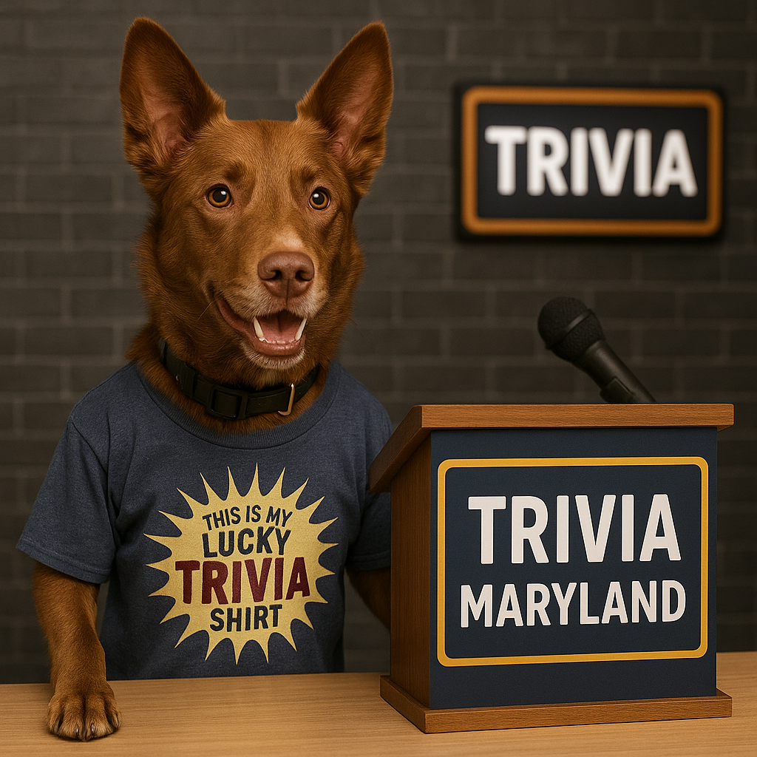
WELCOME TO THE WORLD SERIES
SPRING 2025

Slide 2
HERE ARE YOUR SPRING 2025 WORLD SERIES TEAMS
NORTH REGION
• B-SQUAD(2 TIME)
• LINCOLN LOVES ZJ’S
• MASTER DEBATORS
• NANCY P’S FINANCIAL ADVISORS
• NEPO BABIES
WEST REGION
• ALL OR NOTHING
• FIGHT MILK
• LITE
• OCEAN PANDAS
• TOO FAST, TOO CURIOUS
SOUTH REGION
• BOAT AND HOES
• MIGHTY MIGHTY CROFTONES
• NO IDEA
• PARTIAL RECALL
• TAMING STRANGE
CENTRAL REGION
• MOIST TOWELETTES
• NORFOLK & WAY
• SWEEP THE LEG
• THE WOOKIES
• TRIVIAHOLICS ANOYMOUS
* PREVIOUS TRIVIA MARYLAND WORLD SERIES CHAMPION

Slide 3
QUESTION # 1
TELEVISION
BORN IN GEORGIA, WHAT SINGER WAS THE RUNNER-UP ON THE FIRST SEASON OF AMERICAN IDOL?

Slide 4
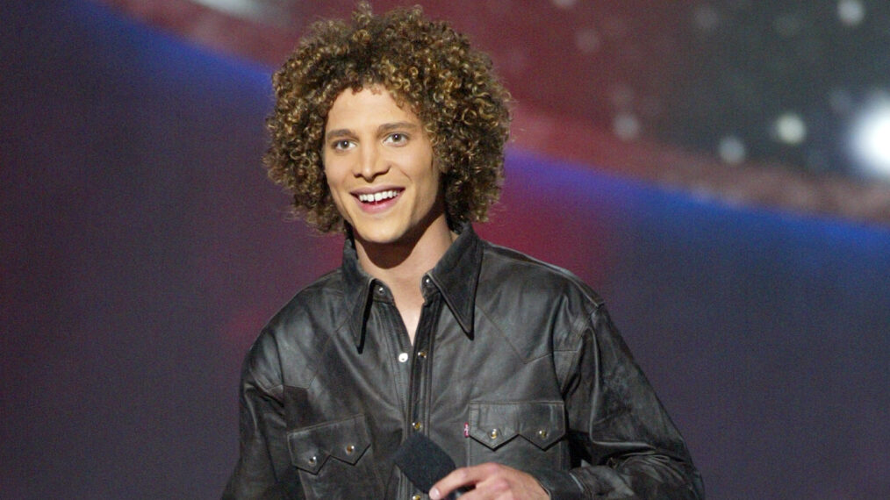
ANSWER # 1
JUSTIN GUARINI

Slide 5
TIE BREAKER QUESTION
ACCORDING TO THE SUEZ CANAL AUTHORITY, HOW MANY TOTAL LNG (LIQUEFIED NATURAL GAS) SHIPS WENT THROUGH THE SUEZ CANAL IN 2024?

Slide 6
QUESTION # 2
ASTROLOGY
3 - PART
USING THE 2025 OFFICIAL DATES (JUNE 20 – SEPTEMBER 22), WHICH THREE ZODIAC SIGNS FALL COMPLETELY WITHIN SUMMER THIS YEAR?

Slide 7
ANSWER # 2
• CANCER
• LEO
• VIRGO

Slide 8
QUESTION # 3
THE MEDIA
IN 2013, WHAT TABLOID HAD THE BRIGHT IDEA TO CHANGE A LETTER IN ITS NAME FOR ONLY ONE DAY TO CELEBRATE THE BIRTH OF PRINCE GEORGE?

Slide 9

ANSWER # 3
THE SUN

Slide 10
QUESTION # 4
THE NATIONAL FOOTBALL LEAGUE
5 - PART
WHAT FIVE QUARTERBACKS WERE DRAFTED IN THE TOP FIVE OVERALL OF A NFL DRAFT AND STARTED AND WON A SUPER BOWL WITH THE TEAM THAT DRAFTED THEM?

Slide 11
ANSWER # 4
• PEYTON MANNING
• TROY AIKMAN
• TERRY BRADSHAW
• JIM McMAHON
• BOB GRIESE

Slide 12
QUESTION # 5
WORLD HISTORY
LISTED FIRST ALPHABETICALLY OF ALL CITIES OVER 250,000 PEOPLE, WHICH WAS ALSO THE FIRST MAJOR GERMAN CITY TO FALL TO THE ALLIES DURING WORLD WAR 2?

Slide 13

ANSWER # 5
AACHEN

Slide 14
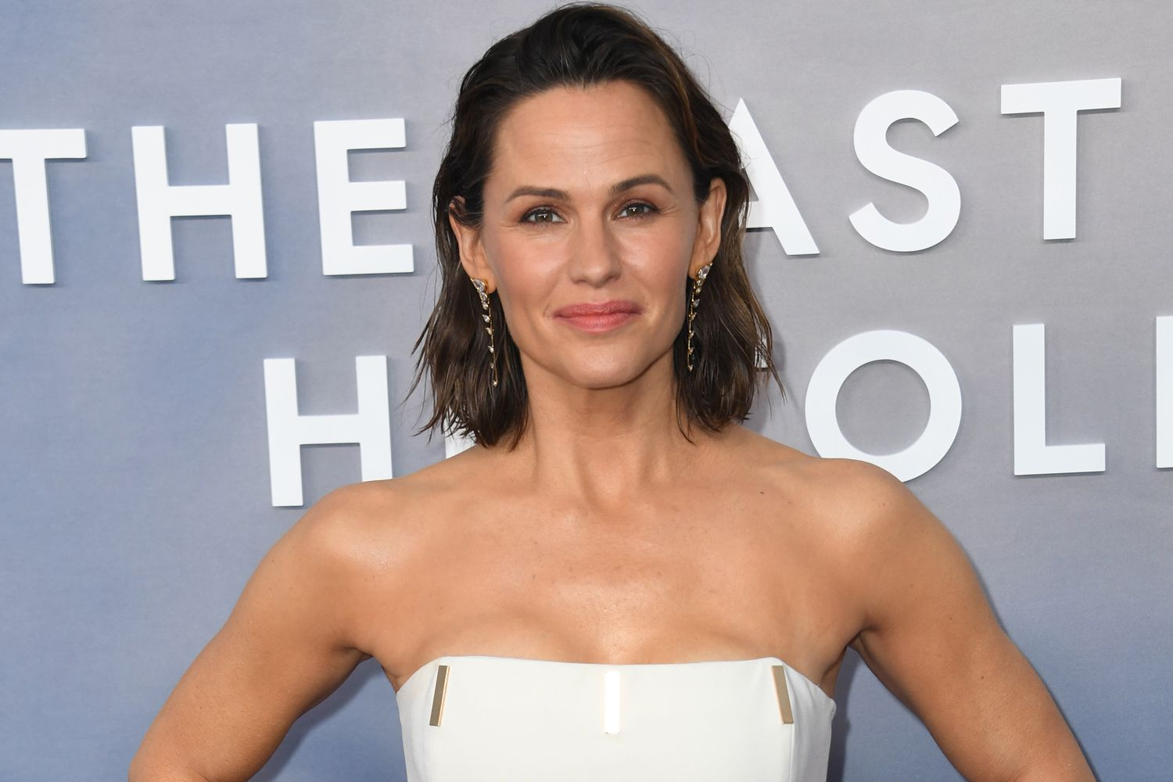
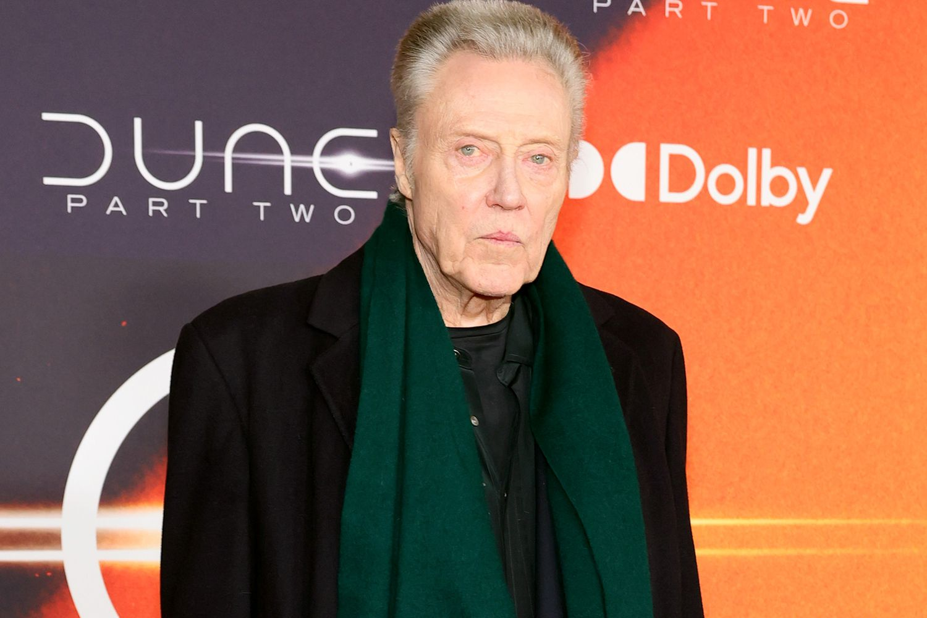

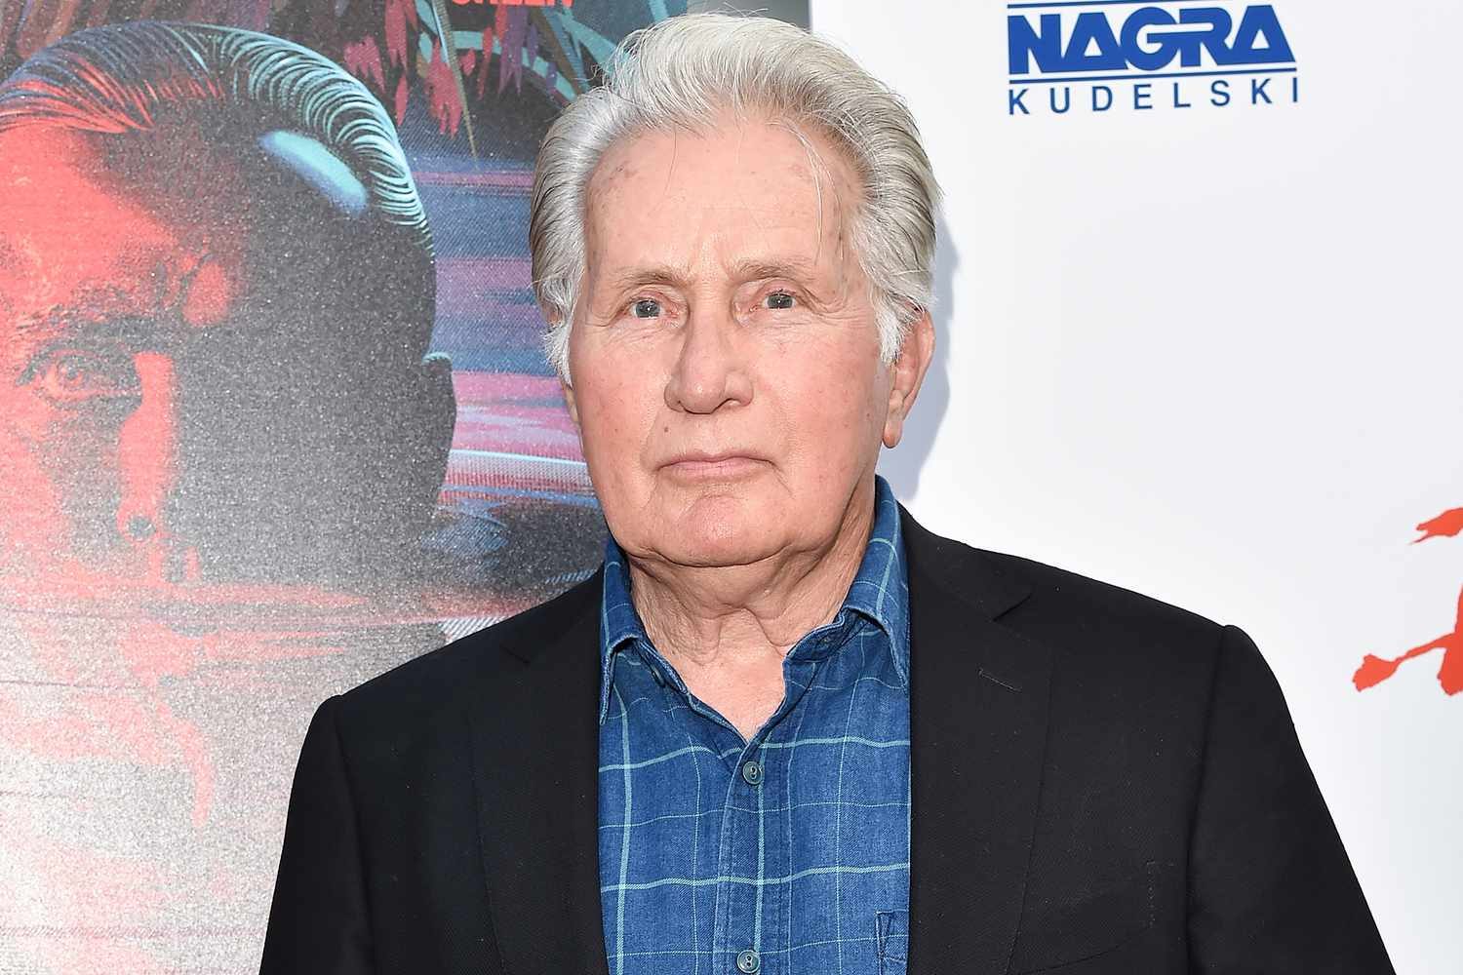
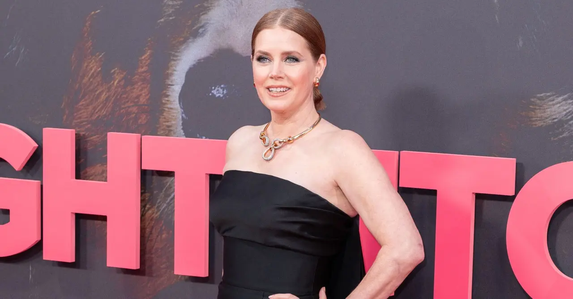
QUESTION # 6
WHO ARE WE AND WHAT FILM DID WE ALL APPEAR IN?

Slide 15
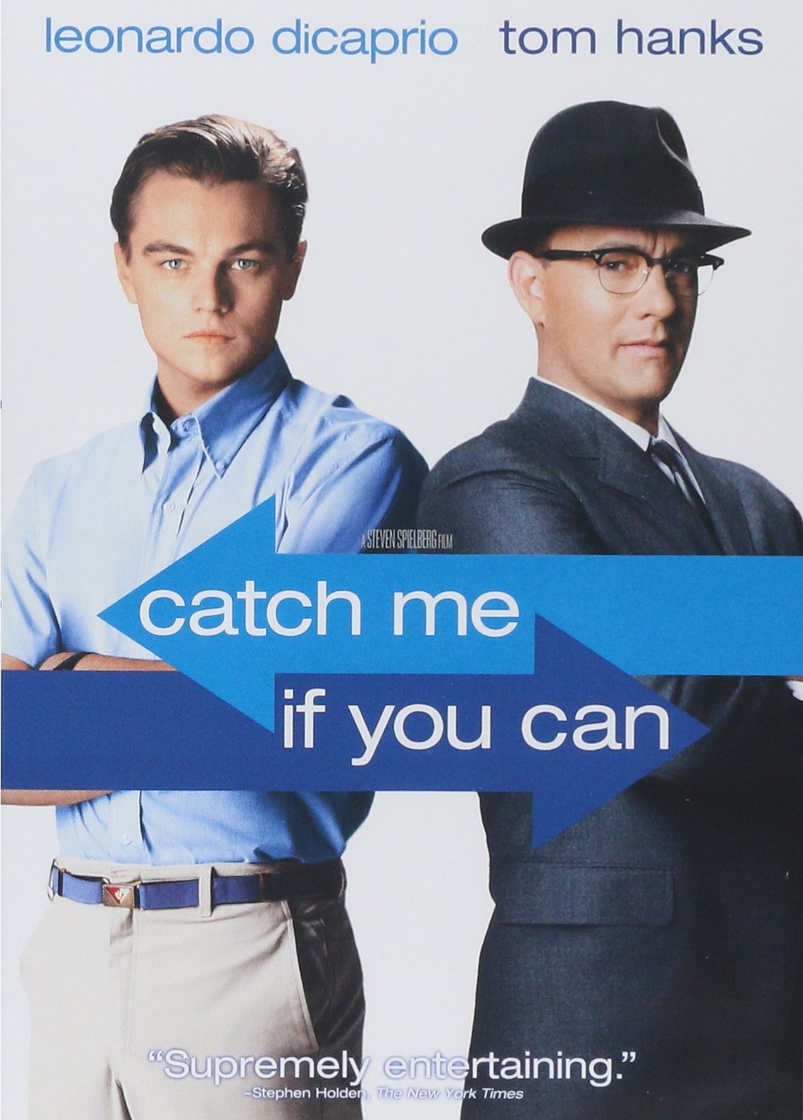
ANSWER # 16
THEY ALL APPEARED IN…

Slide 16
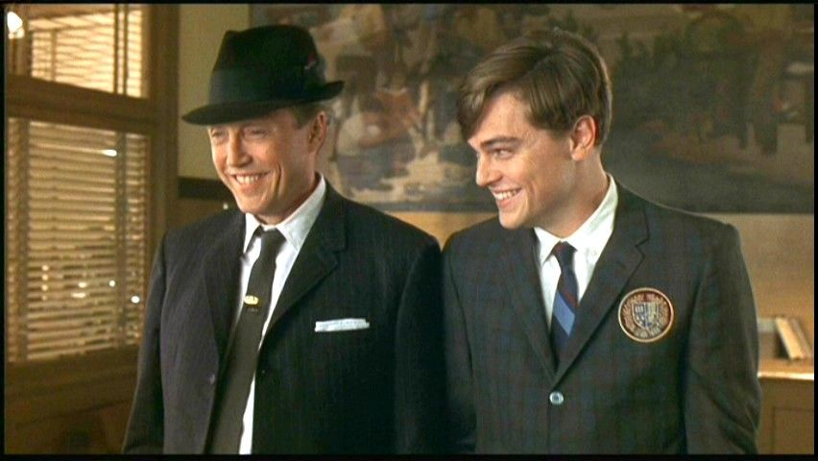
CHRISTOPHER WALKEN

Slide 17
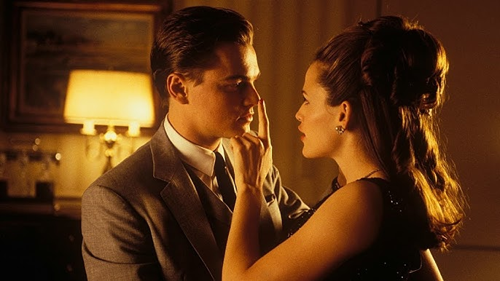
JENNIFER GARNER

Slide 18
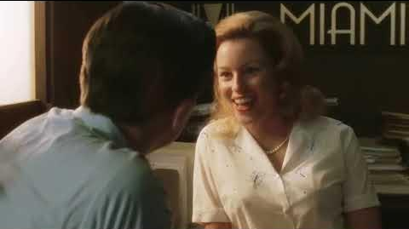
ELIZABETH BANKS

Slide 19
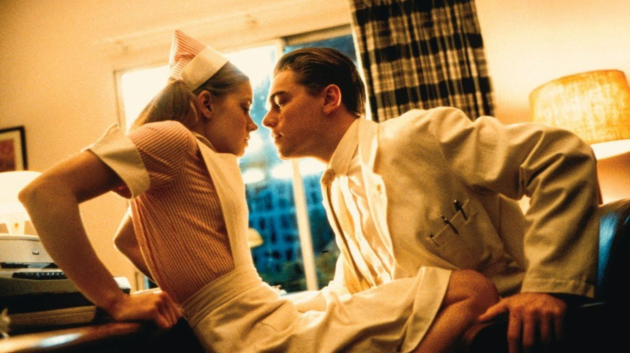
AMY ADAMS

Slide 20
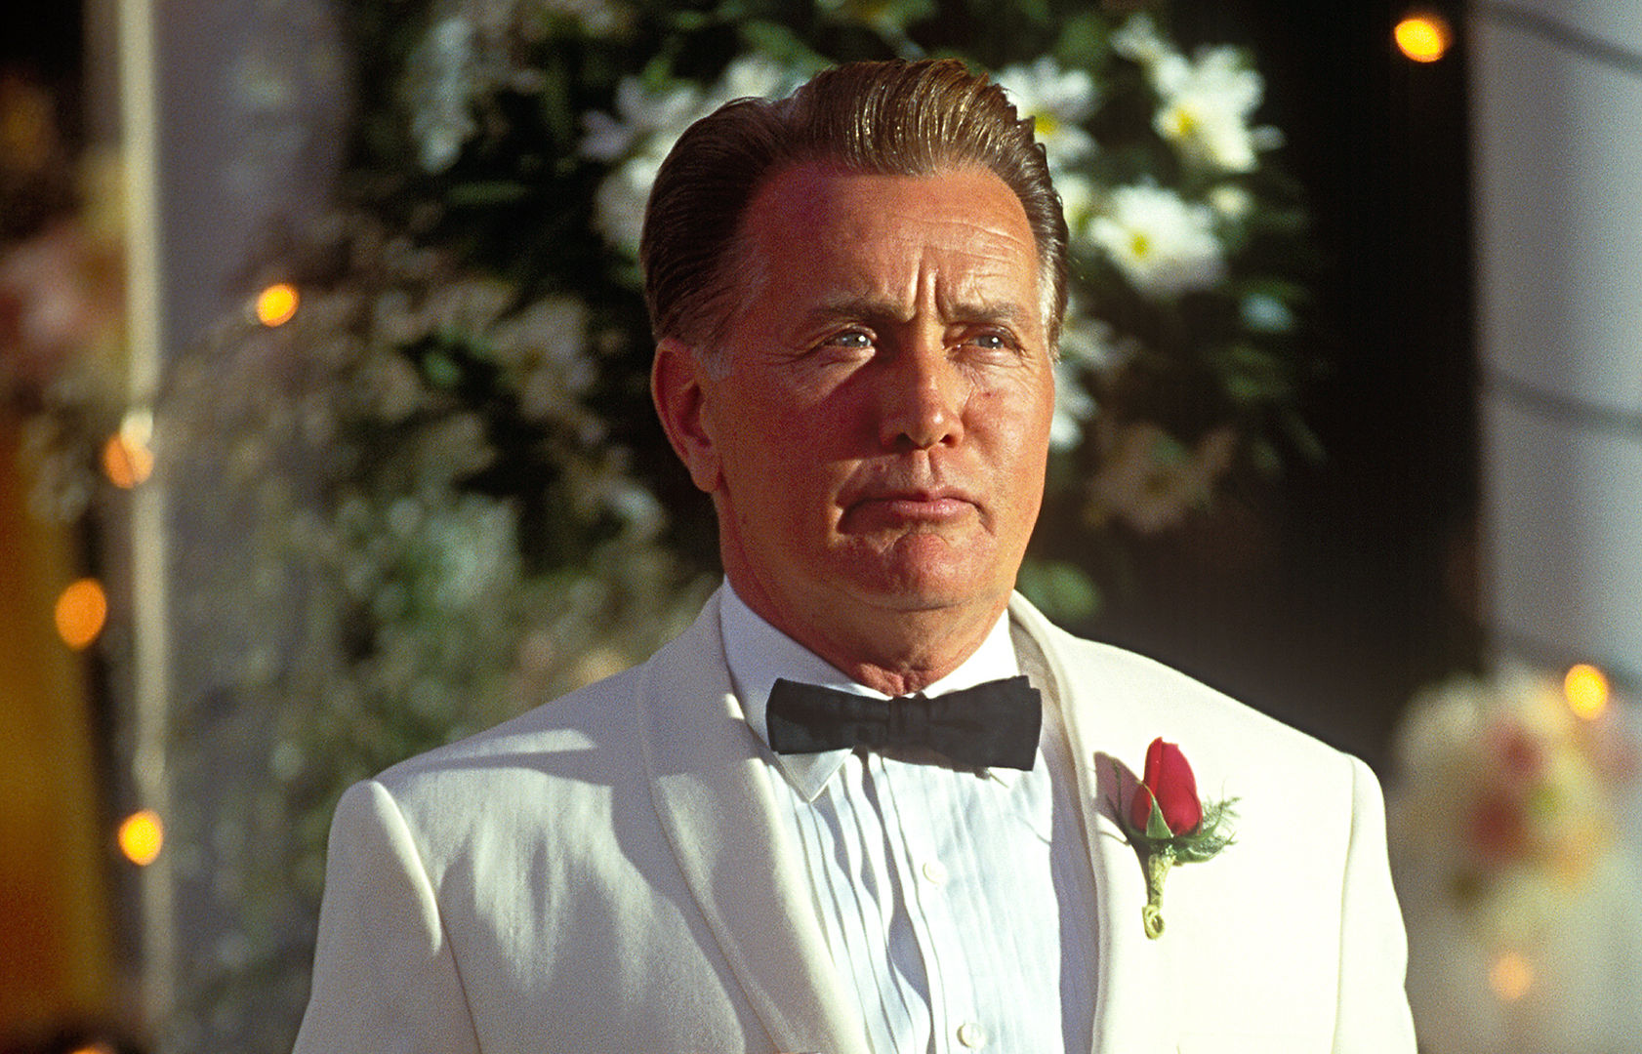
MARTIN SHEEN

Slide 21
QUESTION # 7
SCIENCE
THE FIRST MAMMAL TO BE CLONED FROM AN ADULT CELL, “DOLLY” THE SHEEP IS NOW PRESERVED IN A MUSEUM WHICH BRITISH COUNTRY?

Slide 22
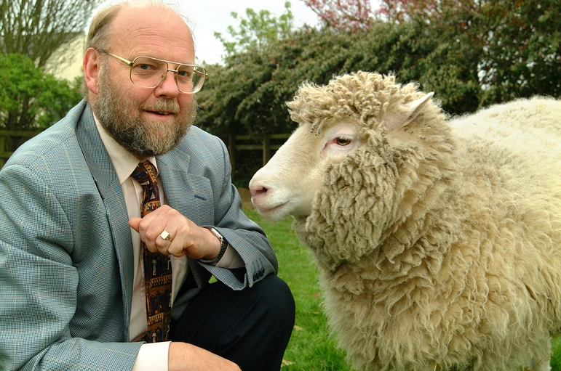
ANSWER # 7
SCOTLAND

Slide 23
QUESTION # 8
GEOGRAPHY
2 - PART
LOCATED IN EASTERN EUROPE, THE KERCH STRAIT CONNECTS WHICH TWO SEAS?

Slide 24
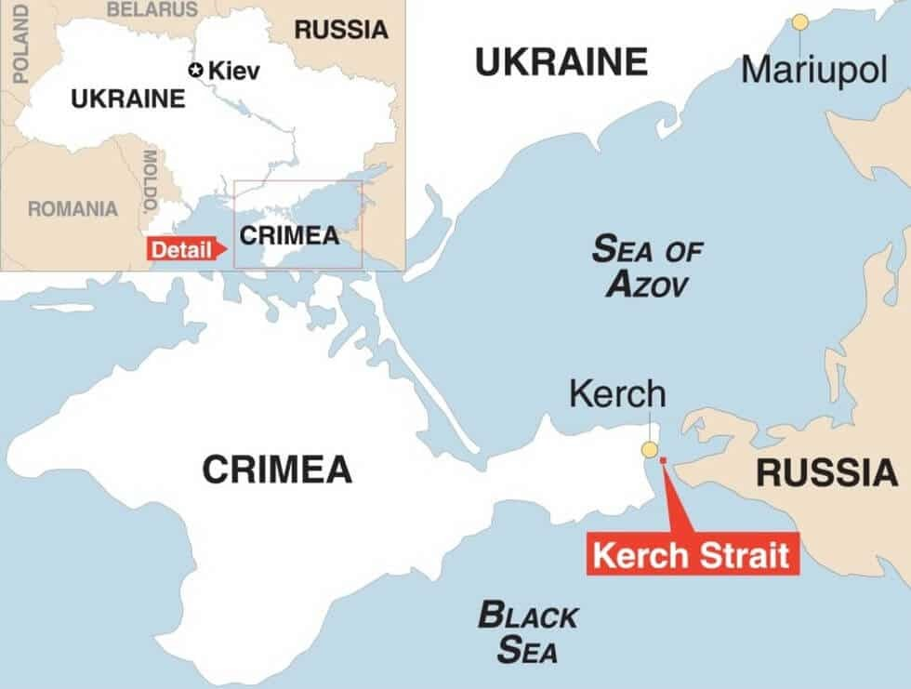
ANSWER # 8
• THE BLACK SEA
• SEA OF AZOV

Slide 25
QUESTION # 9
SNACKS AND WATERS!
CREATED IN TAIWAN AND NOT THE COUNTRY TO THE NORTH IT’S NAMED FOR, WHAT MEAL TYPICALLY CONSISTS OF SLICED FLANK STEAK, ONIONS, AND PEPPERS THAT IS THEN FRIED OVER STEAMED RICE OR NOODLES?

Slide 26
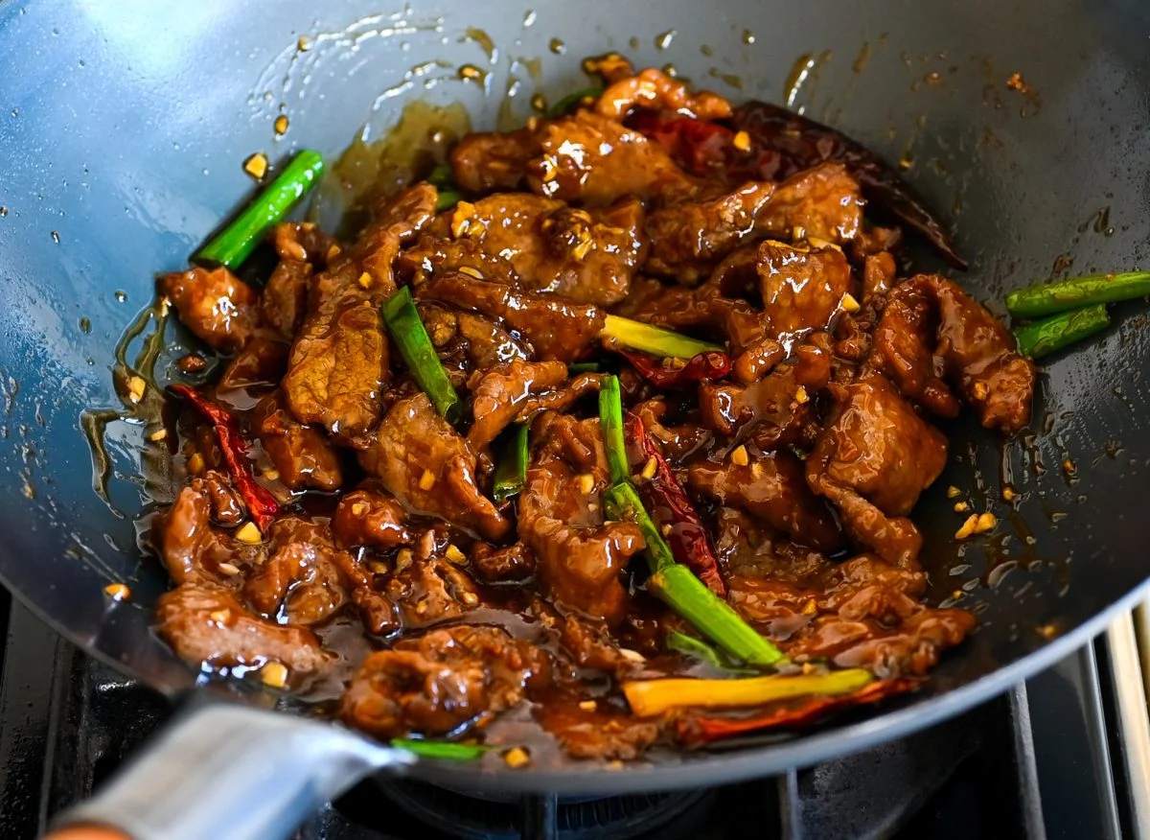
ANSWER # 9
MONGOLIAN BEEF

Slide 27


QUESTION # 10 SOUND
4 - PART
NAME THE FOUR ARTISTS SINGING THIS ELVIS PRESLEY CLASSIC:

Slide 28
ANSWER # 10
ARTIST # 1
MICHAEL BUBLÉ
ARTIST # 2
KACEY MUSGRAVES
ARTIST # 3
BRENDA LEE
ARTIST # 4
RICK ASTLEY

Slide 29

halftime
halftime
100% THIS IS BEER

Slide 30
QUESTION # 11
THE BODY HUMAN
PART OF THE IMMUNE SYSTEM, WHAT LYMPHOID ORGAN MAKES AND “TRAINS” WHITE BLOOD CELLS TO PROTECT AGAINST INFECTION?

Slide 31
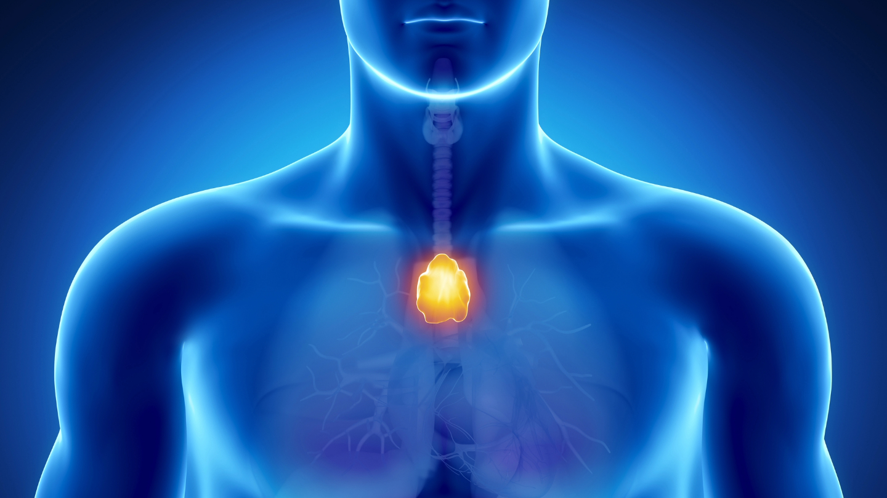
ANSWER # 11
THYMUS

Slide 32
QUESTION # 12
POLITICS
3 - PART
WHO ARE THE ONLY THREE U.S. PRESIDENTS TO ALSO SERVE NON-CONSECUTIVE TERMS AS A STATE GOVERNOR?

Slide 33
ANSWER # 12
• JAMES MONROE
• RUTHERFORD B. HAYES
• BILL CLINTON

Slide 34
QUESTION # 13
NAMES THE SAME
THE TITLE OF THE FILM WHICH WAS NAMED BEST PICTURE AT THE 78TH ACADEMY AWARDS
OR
THE TERM USED FOR A GROUP OF RHINOCEROSES

Slide 35
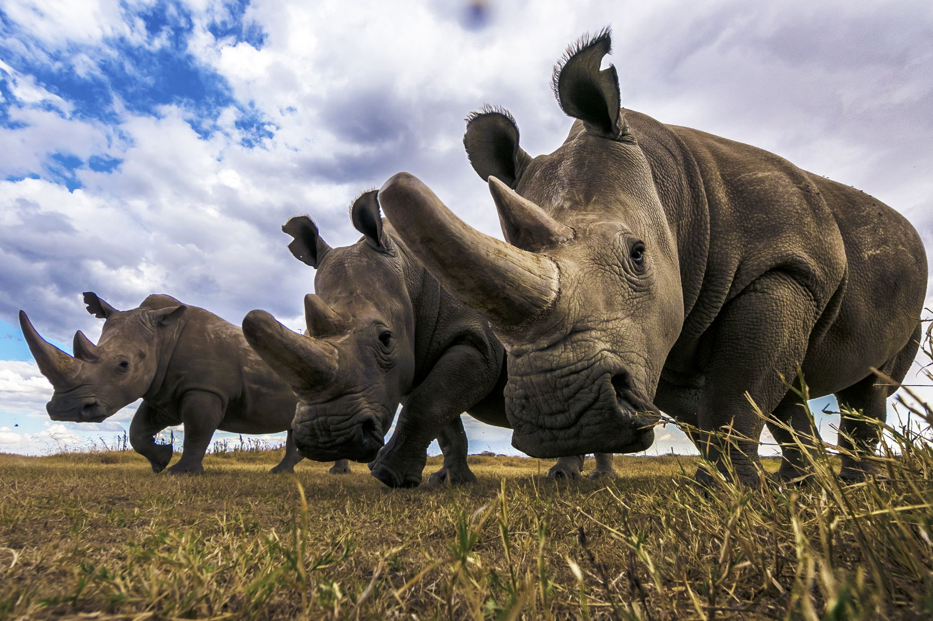
ANSWER # 13
“CRASH”

Slide 36
QUESTION # 14
VIDEO GAMES
4 - PART
ONE OF THE MOST ICONIC VIDEO GAME SERIES OF ALL TIME, WHAT FOUR LEGEND OF ZELDA GAMES HAVE THE WORD “LINK” IN THEIR TITLE?
NOTE: SPIN-OFFS ARE NOT INCLUDED

Slide 37
ANSWER # 14
• THE ADVENTURE OF LINK
• A LINK TO THE PAST
• LINK’S AWAKENING
• A LINK BETWEEN WORLDS

Slide 38
QUESTION # 15
TRANSPORTATION
COBALT BLUE WITH WHITE PAINTED ON NUMBERS AND MADE OF IRON WITH A PORCELAIN ENAMEL, WHICH EAST COAST STATE WAS THE FIRST TO ISSUE LICENSE PLATES?

Slide 39
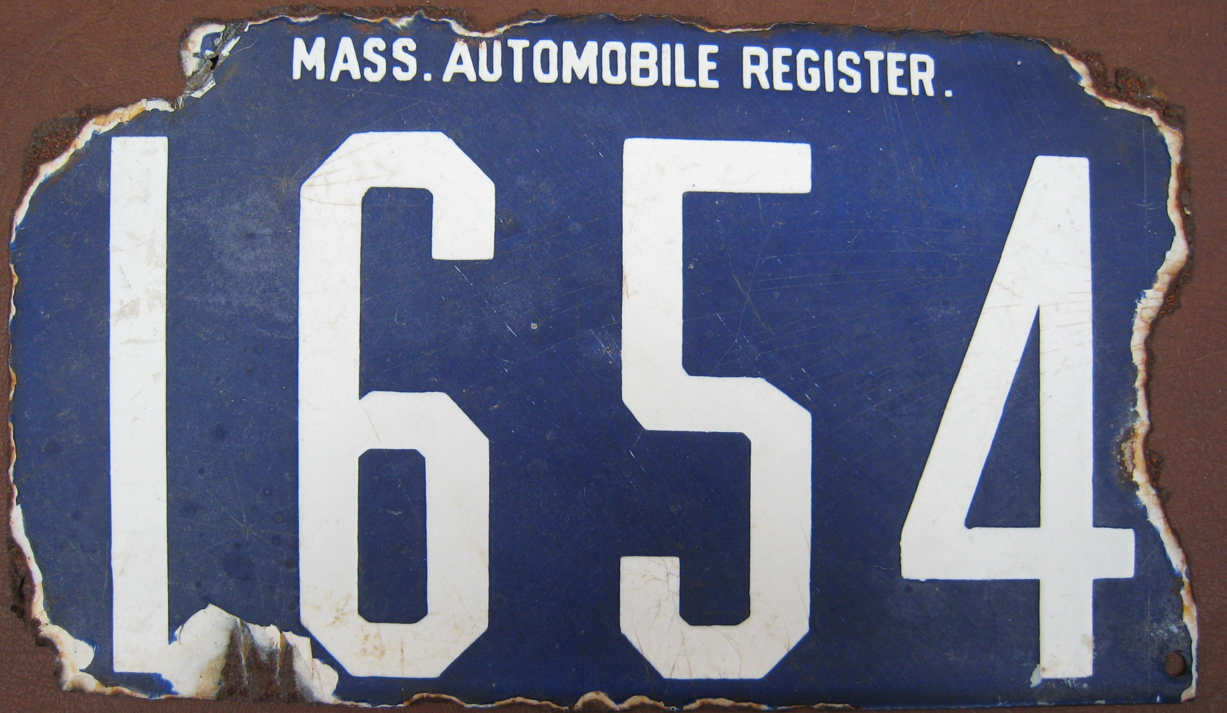
ANSWER # 15
MASSACHUSETTS

Slide 40
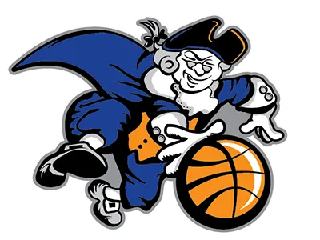




QUESTION # 16
NAME THE FOLLOWING NORTH AMERICAN PROFESSIONAL SPORTS TEAMS

Slide 41
ANSWER # 6
CHICAGO CUBS
(1911 - 1914)

Slide 42

DENVER BRONCOS
(1960 - 1961)

Slide 43

COLUMBUS CREW
(1996 - 2014)

Slide 44
NEW YORK KNICKS
(1946 - 1947)

Slide 45

TORONTO MAPLE LEAFS
(1926 - 1927)

Slide 46
QUESTION # 17
FUN AND GAMES
FAMILIAR TO THOSE WHO PLAY DUNGEONS AND DRAGONS, A DODECAHEDRON IS A DIE THAT HAS HOW MANY SIDES?

Slide 47
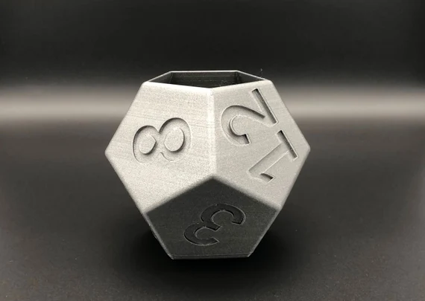
ANSWER # 17
12

Slide 48
QUESTION # 18
7 – 3 – 1
⑦ BORN KAYLEIGH ROSE AMSTUTZ BEFORE CHANGING HER NAME
③ A MISSOURIAN, SHE STARTED PERFORMING AT AGE 12 BEFORE RELEASING HER FIRST SINGLE IN 2017
① AT THIS YEAR’S GRAMMYS, SHE WON THE AWARD FOR BEST NEW ARTIST

Slide 49
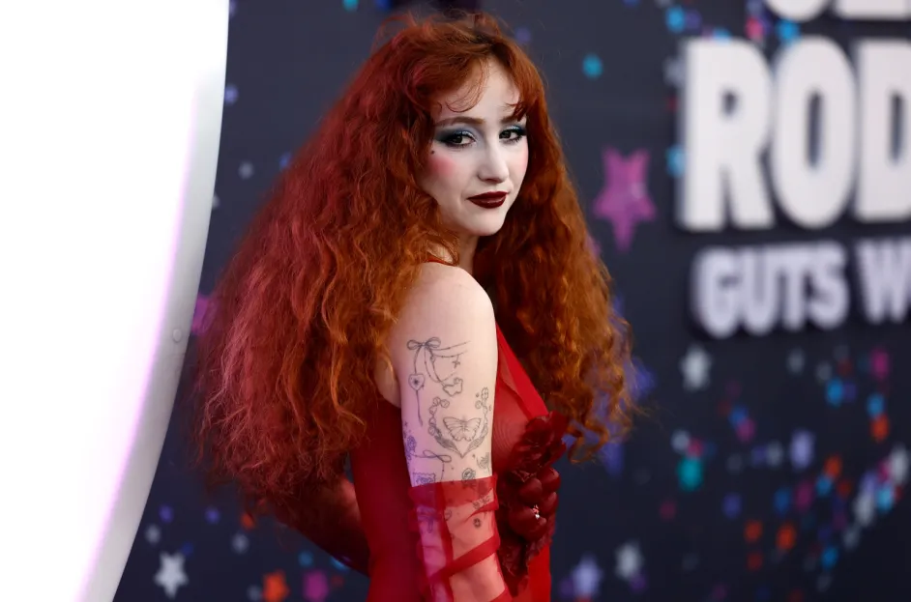
ANSWER # 18
CHAPPELL ROAN

Slide 50
QUESTION # 19
PAST TIMES
ONE OF THE OLDEST BALLROOM DANCES STILL WIDELY PERFORMED, WHAT DANCE STYLE EXISTS IN BOTH A SLOW FLOWING “ENGLISH” VERSION AND A FASTER MORE ROTATIONAL “VIENNESE” VERSION?

Slide 51
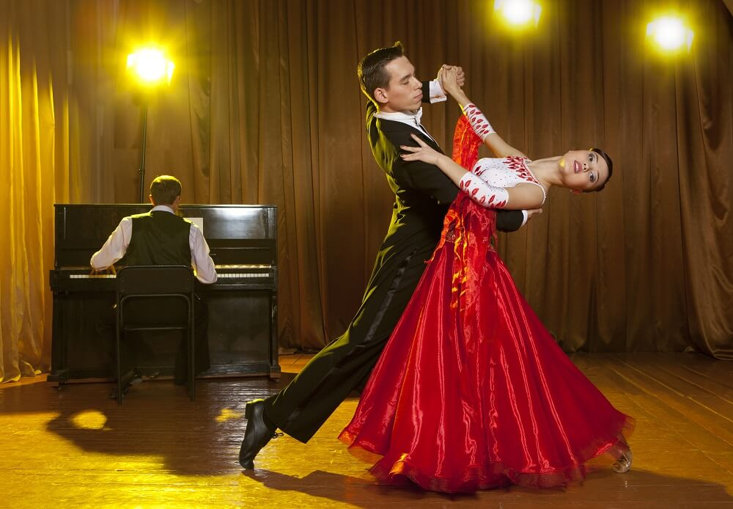
ANSWER # 19
WALTZ

Slide 52
QUESTION # 20
FAMOUS FAMILIES
WAGER UP TO 15 POINTS
TRYING TO TOP HIS FATHER’S HEISMAN TROPHY WIN, WHAT ENTERTAINER WAS ONCE NAMED PEOPLE MAGAZINE’S “SEXIEST MAN ALIVE”

Slide 53

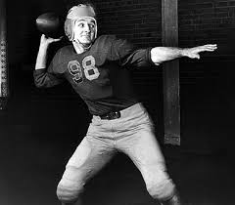
ANSWER # 20
MARK HARMON

Slide 54

triviamaryland
triviamaryland

Slide 55
TIE BREAKER ANSWER
119

