Slide 1
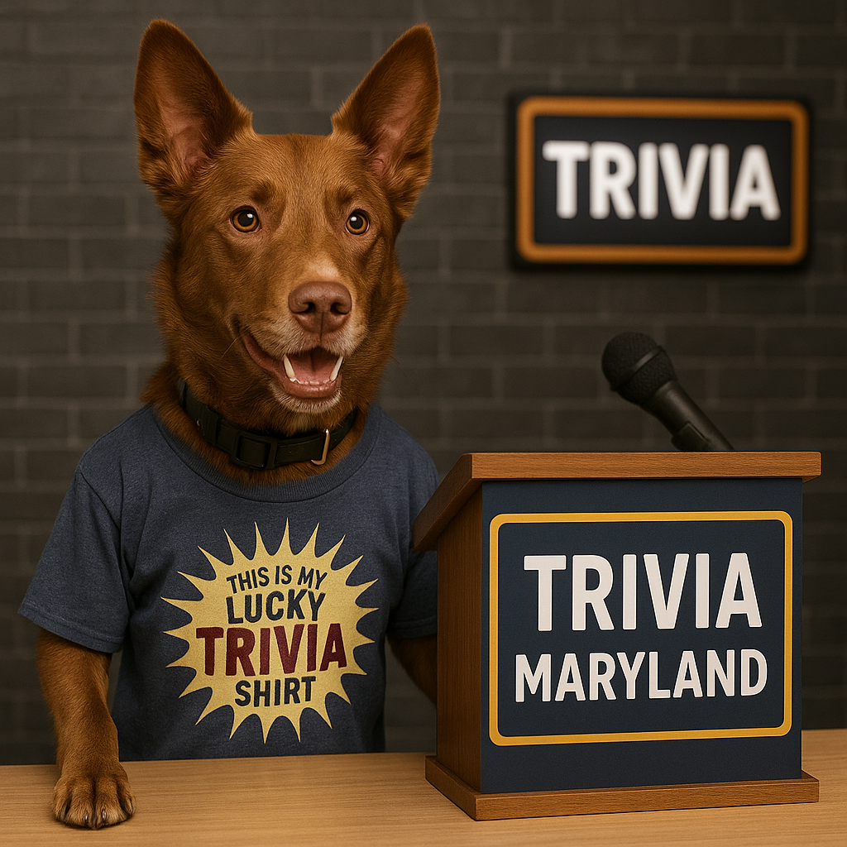
WELCOME TO THE WORLD SERIES
SUMMER 2025

Slide 2
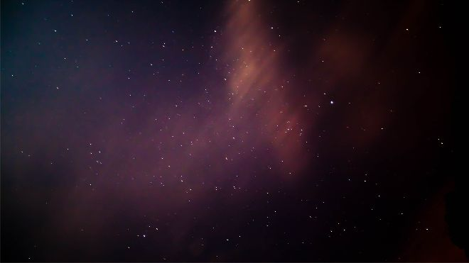
WOOKIES
LINCOLN LOVES ZJ’S
ONE MINUTE REMAININ
CLUB PENGUIN
B SQUAD
DICKY LOVELADY
FAT KIDS
COUSIN EDDIE’S KIDS
BAD COMPANY
SQUANDERERS
ZESTY HOT COURAGE
MARKSMEN
THINKIN N DRINKIN
50/50/90
LITE
PIKACHUPACABRAS
MAXIMUM SPARKLE
MY COUCH PULLS OUT…
SENIOR MOMENTS
TABBIES
Notes:
North, Central, West, South

Slide 3
QUESTION # 1
WORLD HISTORY
SHARING ITS NAME WITH A SPACE SHUTTLE, WHAT WAS THE NAME OF THE SPACECRAFT THAT SERVED AS THE COMMAND MODULE FOR APOLLO 11 IN JULY 1969?

Slide 4
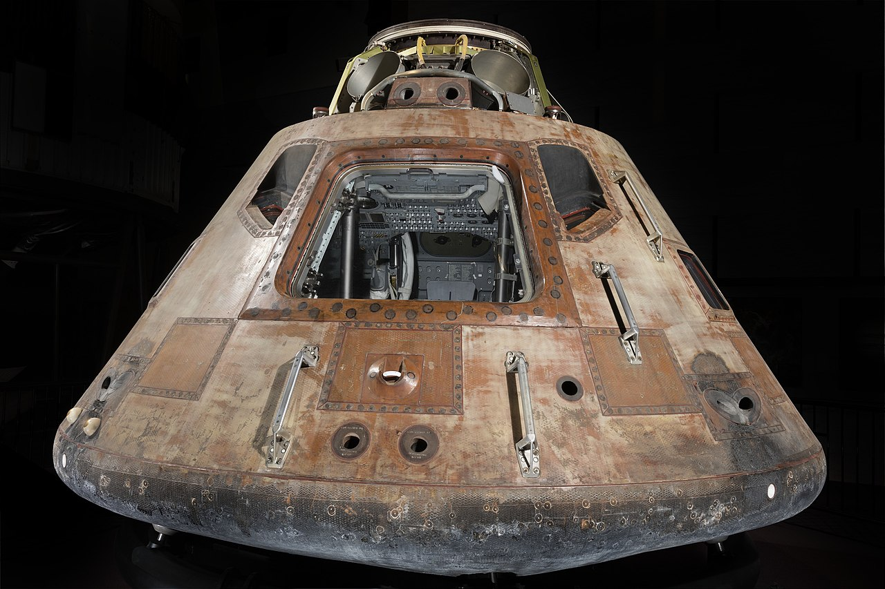
ANSWER # 1
COLUMBIA

Slide 5
TIE BREAKER QUESTION
ACCORDING TO HOCKEY REFERENCE, HOW MANY TOTAL PENALTY MINUTES HAS ALEXANDER OVECHKIN RECEIVED DURING THE REGULAR SEASON IN HIS CAREER?

Slide 6
QUESTION # 2
MUSIC
2 - PART
RELEASED SIX YEARS APART, WHAT ARE TAYLOR SWIFT’S TWO BEST SELLING STUDIO ALBUMS IN THE UNITED STATES?
NOTE: RE-RECORDINGS NOT INCLUDED

Slide 7
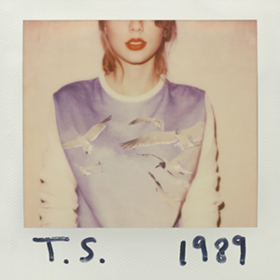

ANSWER # 2
•1989
• FEARLESS

Slide 8
QUESTION # 3
LITERATURE
INDUSTRIAL SOCIETY AND ITS FUTURE WAS AN ANTI-TECHNOLOGY ESSAY AUTHORED IN 1995 BY WHAT PERSON?
Notes:
Unabomber is NOT acceptable

Slide 9
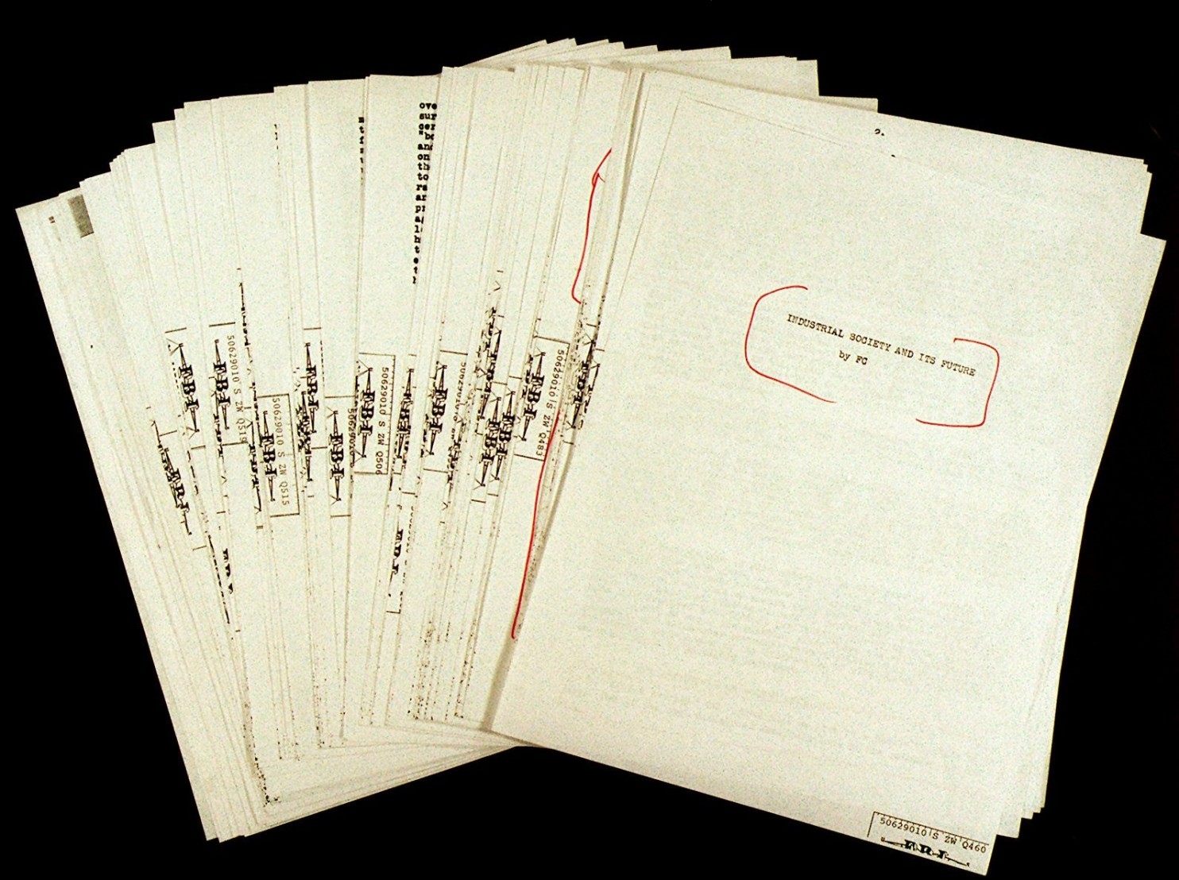
ANSWER # 3
TED KACZYNSKI

Slide 10
QUESTION # 4
VIDEO GAMES
4 - PART
ACCORDING TO ELECTRONIC ARTS (EA), WHICH FOUR NFL PLAYERS THAT ARE ON A TEAM IN THE AMERICAN FOOTBALL CONFERENCE HAD A 99 RATING IN MADDEN NFL 26 WHEN IT WAS FIRST RELEASED LAST JULY?

Slide 11
ANSWER # 4
• LAMAR JACKSON
• JOSH ALLEN
• JA’MARR CHASE
• MYLES GARRETT

Slide 12
QUESTION # 5
ETYMOLOGY
WHAT TERM ORIGINATED FROM A PHYSICAL BOUNDARY THAT WAS PAINTED AT ANDERSONVILLE PRISON WHERE PRISONERS WOULD BE SHOT IF THEY PASSED IT?

Slide 13

ANSWER # 5
“DEADLINE”

Slide 14
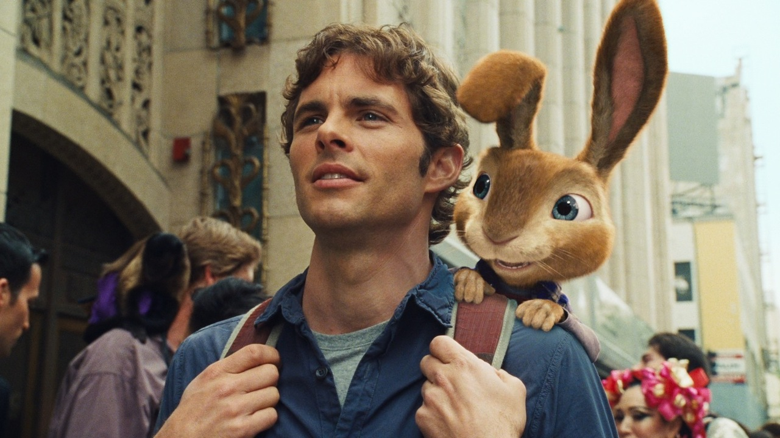
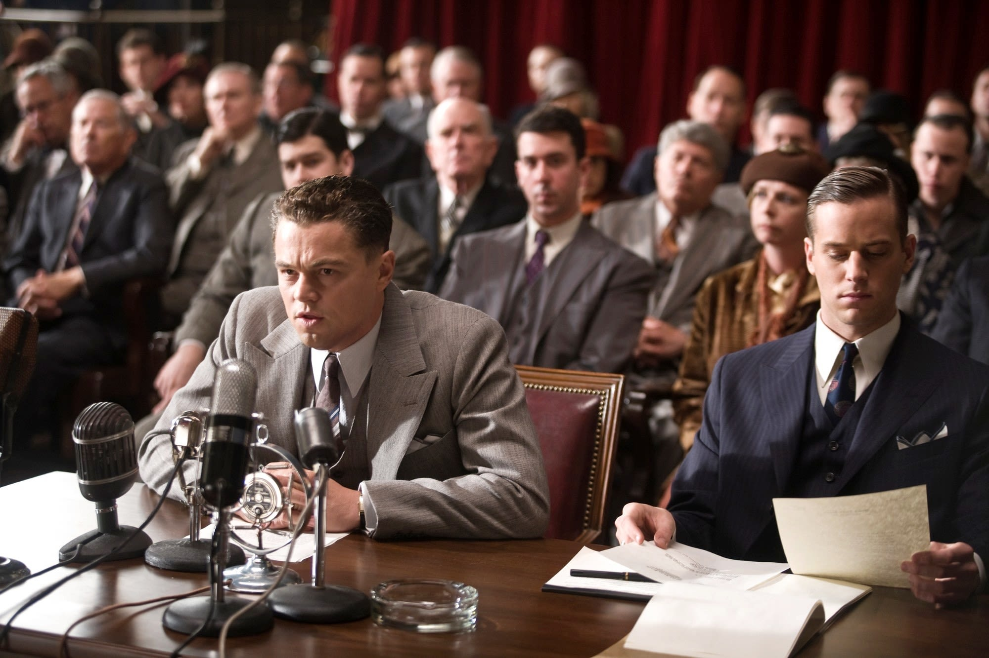
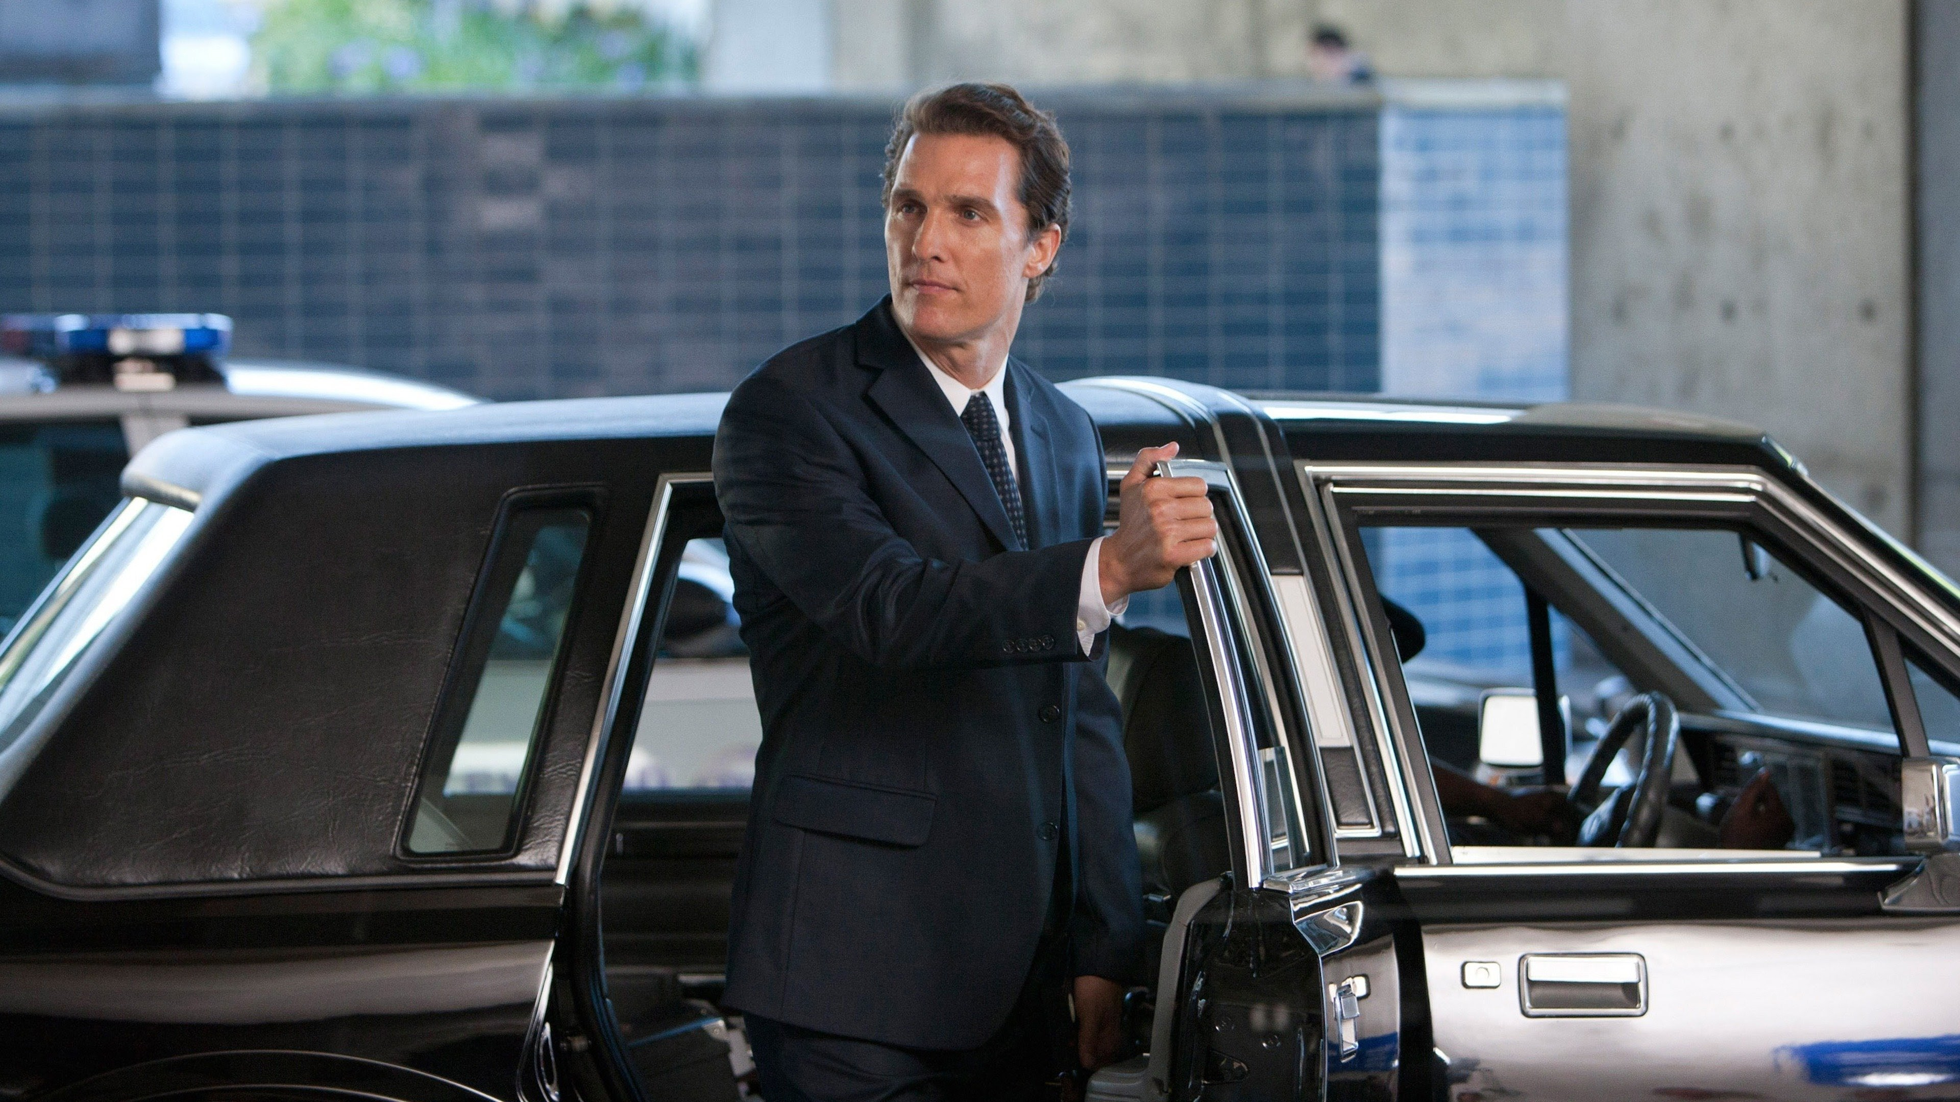
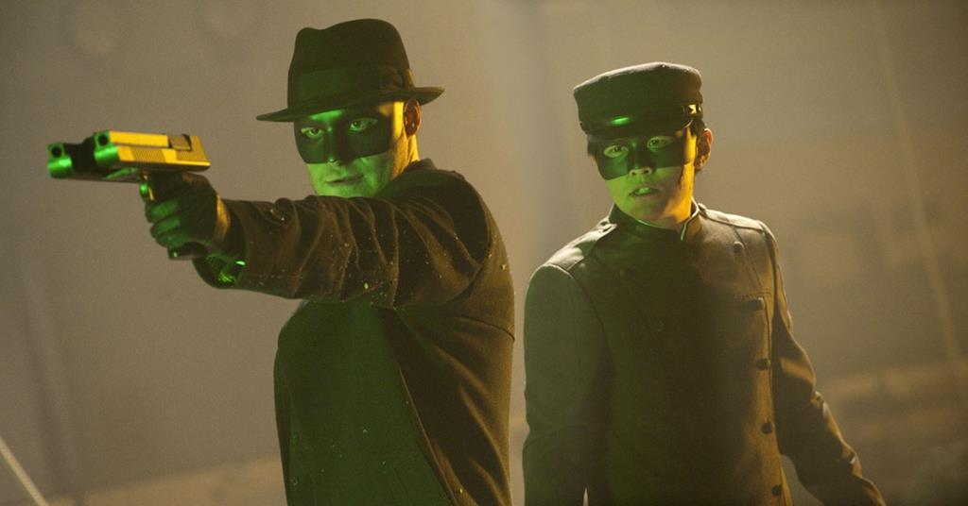
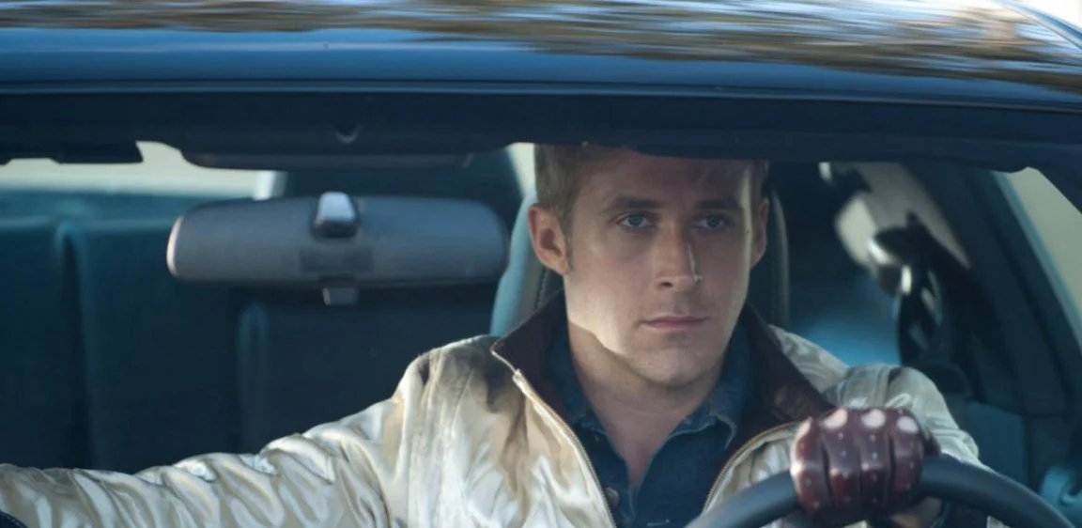
QUESTION # 6
NAME THE FILM AND THE YEAR THEY WERE ALL RELEASED

Slide 15
ANSWER # 16
THE LINCOLN LAWYER

Slide 16
HOP

Slide 17
DRIVE

Slide 18
J. EDGAR

Slide 19
THE GREEN HORNET

Slide 20
THEY WERE ALL RELEASED IN…
2011

Slide 21
QUESTION # 7
THE BODY HUMAN
IF A MEDICATION IS LABELED “QID,” HOW OFTEN SHOULD IT BE TAKEN?

Slide 22
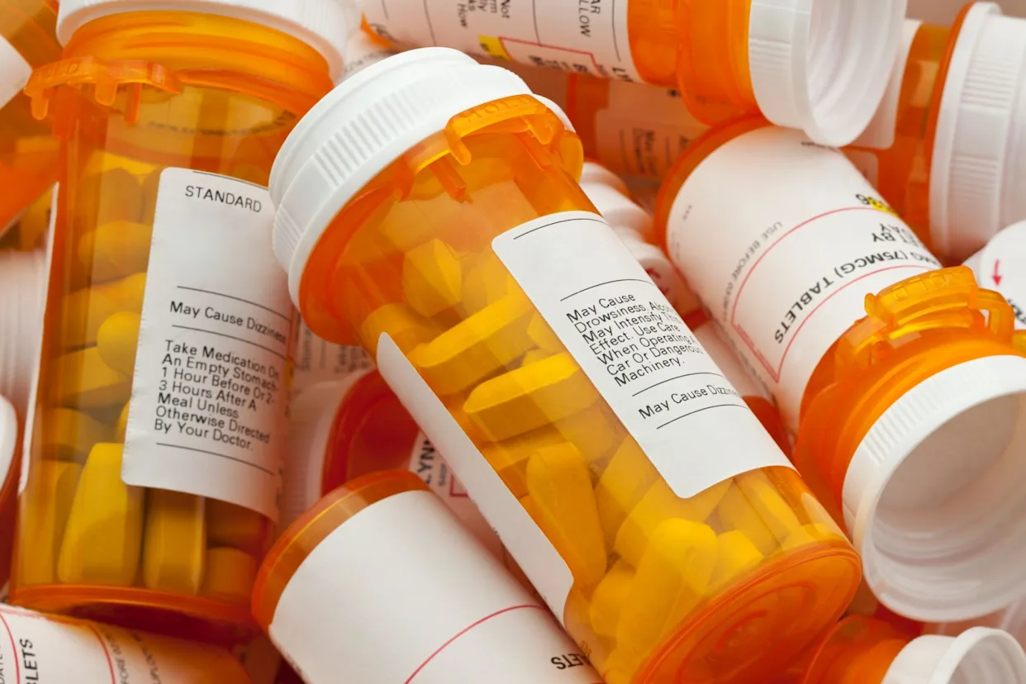
ANSWER # 7
“FOUR TIMES A DAY”

Slide 23
QUESTION # 8
HANDSOME DEVILS
4 - PART
OF THE 2,817 CELEBRITIES HONORED WITH A STAR ON THE HOLLYWOOD WALK OF FAME, WHICH FOUR ARE DOGS?

Slide 24
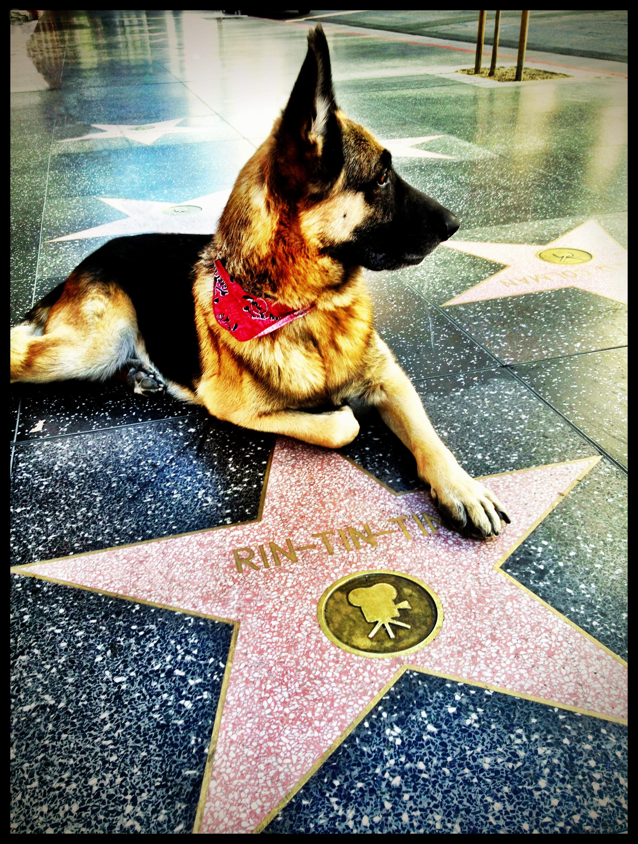
ANSWER # 8
• LASSIE
• RIN TIN TIN
• SNOOPY
• STRONGHEART

Slide 25
QUESTION # 9
ROCKS AND MINERALS
WHICH FIERY GEM IS THE BIRTHSTONE FOR THOSE BORN IN JULY?

Slide 26
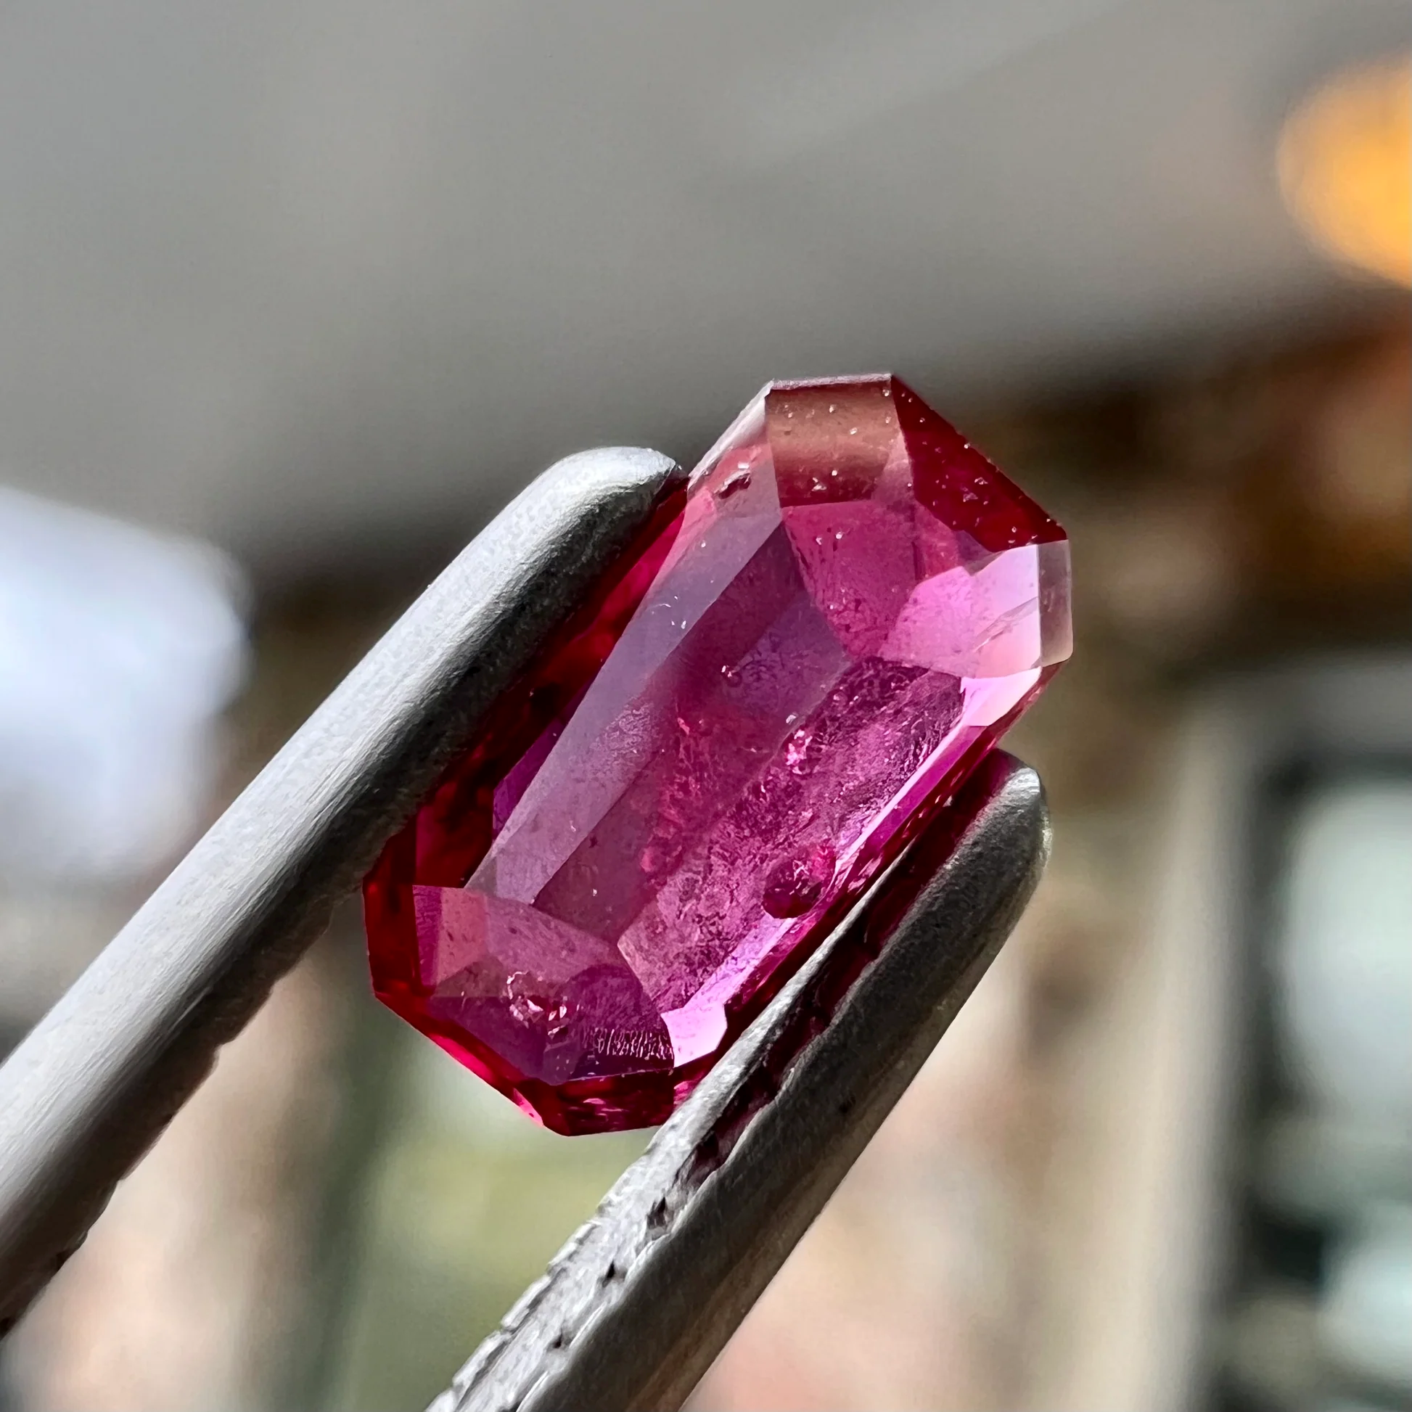
ANSWER # 9
RUBY

Slide 27
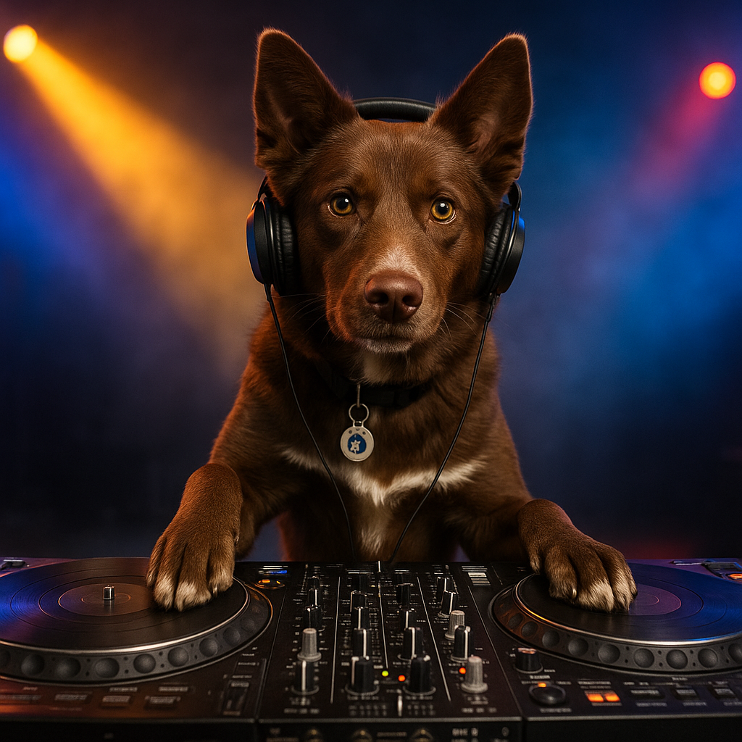

QUESTION # 10 SOUND
3 - PART
NAME THE THREE GROUPS SINGING THIS BEATLES CLASSIC:

Slide 28
ANSWER # 10
GROUP # 1
THE SUPREMES
GROUP # 2
SOUNDGARDEN
GROUP # 3
GODSMACK

Slide 29

halftime
halftime
100% THIS IS BEER

Slide 30
QUESTION # 11
HOLLYWOOD
WHAT MODEL AND CAR SALESMAN LIED ABOUT HIS EXPERIENCE, SHOWED UP IN A SUIT, A ROLEX, AND SLIPPED PAST A DISTRACTED RECEPTIONIST TO LAND THE ROLE OF JAMES BOND IN 1969?

Slide 31
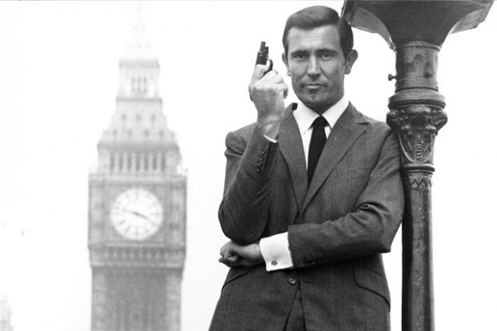
ANSWER # 11
GEORGE LAZENBY

Slide 32
QUESTION # 12
THE BALTIMORE ORIOLES
4 - PART
WHAT FOUR HITTERS HAVE HIT AT LEAST FIVE HOME RUNS THAT HAVE LANDED ON EUTAW STREET WHILE PLAYING FOR THE ORIOLES?

Slide 33
ANSWER # 12
• ANTHONY SANTANDER (11)
• CHRIS DAVIS (11)
• LUKE SCOTT (6)
• RAFAEL PALMEIRO (5)

Slide 34
QUESTION # 13
INSTRUMENTS
PLAYED BY THE UNIVERSITY OF TEXAS MARCHING BAND AND STANDING OVER 9 FEET TALL, “BIG BERTHA 2” IS THE WORLD’S LARGEST TYPE OF WHICH DRUM?

Slide 35
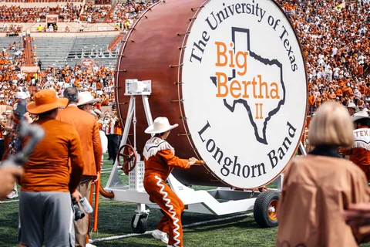
ANSWER # 13
BASS

Slide 36
QUESTION # 14
CONNECTIONS
1. THE ONLY U.S. STATE WHOSE OFFICIAL POSTAL ABBREVIATION IS TWO VOWELS
2. ONLY U.S. PRESIDENT WHO WAS BORN IN # 1
3. COMMON HOUSEHOLD ITEM THAT SHARES THE SAME LAST NAME AS # 2
4. CHARACTER NAME OF CANTANKEROUS # 3 IN AN 1987 ANIMATED FILM
5. # 4 IS THE PROTAGONIST IN A SERIES OF GAMES FOR WHICH VIDEO GAME COMPANY

Slide 37
ANSWER # 14
1 - IOWA (IA)
2 - HERBERT HOOVER
3 - VACUUM CLEANER
4 - “KIRBY” (BRAVE LITTLE TOASTER)
5 – NINTENDO

Slide 38
QUESTION # 15
GEOGRAPHY
HOME TO A NAVAL AIR STATION AND THE USS LEXINGTON, WHAT ALLITERATIVELY NAMED CITY IS THE EIGHTH-MOST POPULATED CITY IN TEXAS?

Slide 39
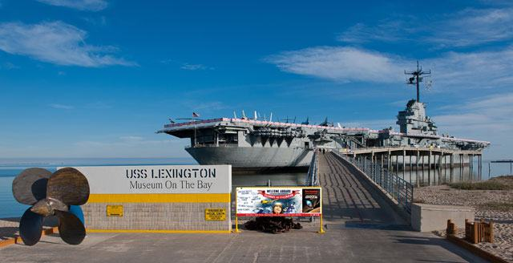
ANSWER # 15
CORPUS CHRISTI

Slide 40





QUESTION # 16
NAME THE COUNTRIES FROM THE SUN THAT IS DEPICTED ON THEIR FLAG

Slide 41

ANSWER # 16
ARGENTINA

Slide 42

ECUADOR

Slide 43

ANTIGUA AND BARBUDA

Slide 44

KYRGYZSTAN

Slide 45

URUGUAY

Slide 46
QUESTION # 17
NATURE
ACCORDING TO THE U.S. GEOLOGICAL SURVEY,
WHICH GROUP OF PLANTS OR TREES PRODUCE THEIR SEEDS IN CONES?

Slide 47
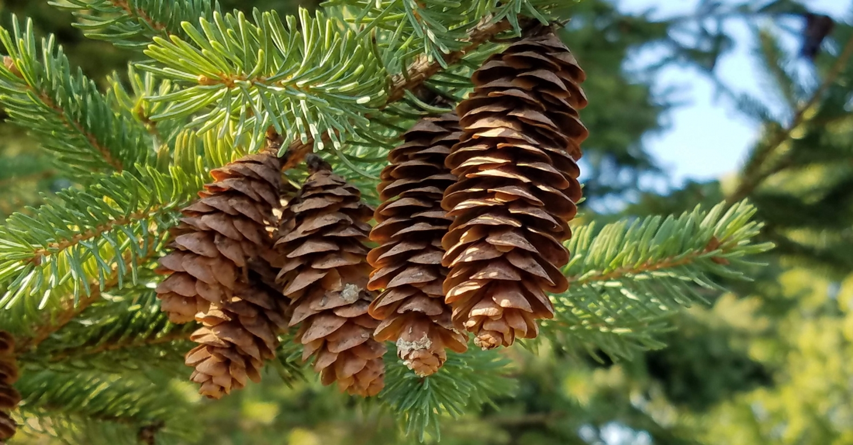
ANSWER # 17
CONIFERS

Slide 48
QUESTION # 18
7 – 3 – 1
⑦ THIS COMPANY WAS FOUNDED IN 1892 AS A SUPPLIER FOR THE ELITE OUTDOORSMAN
③ OUTFITTED GEAR FOR THEODORE ROOSEVELT’S SAFARI TRIPS, CHARLES LINDBERGH’S HISTORIC ATLANTIC FLIGHT, AND RICHARD E. BYRD’S EXPEDITION TO ANTARCTICA
① NOW TAILORED TO THE 20’s TO 40’s CROWD AND “SUMMER GIRLS” ACCORDING TO LFO…

Slide 49
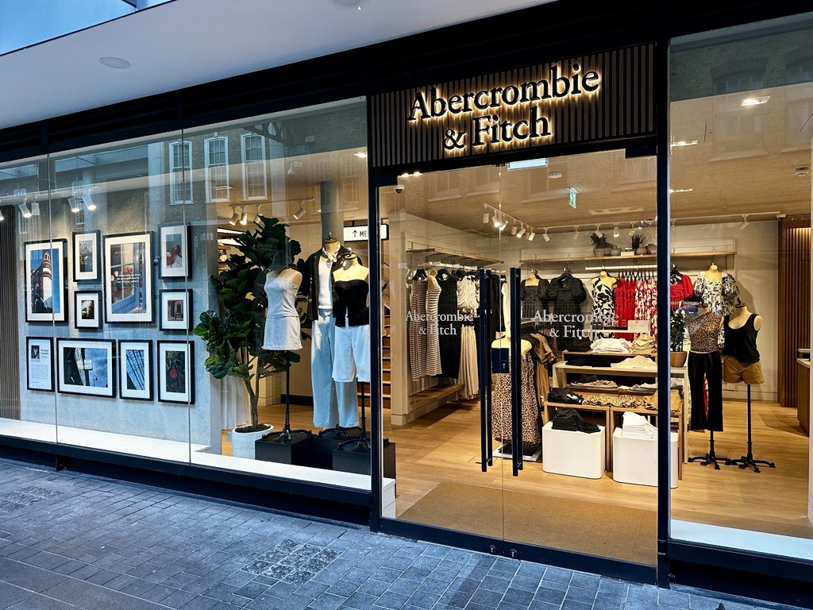
ANSWER # 18
ABERCROMBIE & FITCH

Slide 50
QUESTION # 19
SNACKS AND WATERS!
GROWN FOR ITS RHIZOMES WHICH ARE GROUND INTO A PASTE, WHAT CONDIMENT IN AMERICA IS ACTUALLY A MIXTURE OF HORSERADISH, MUSTARD, AND FOOD COLORING?

Slide 51
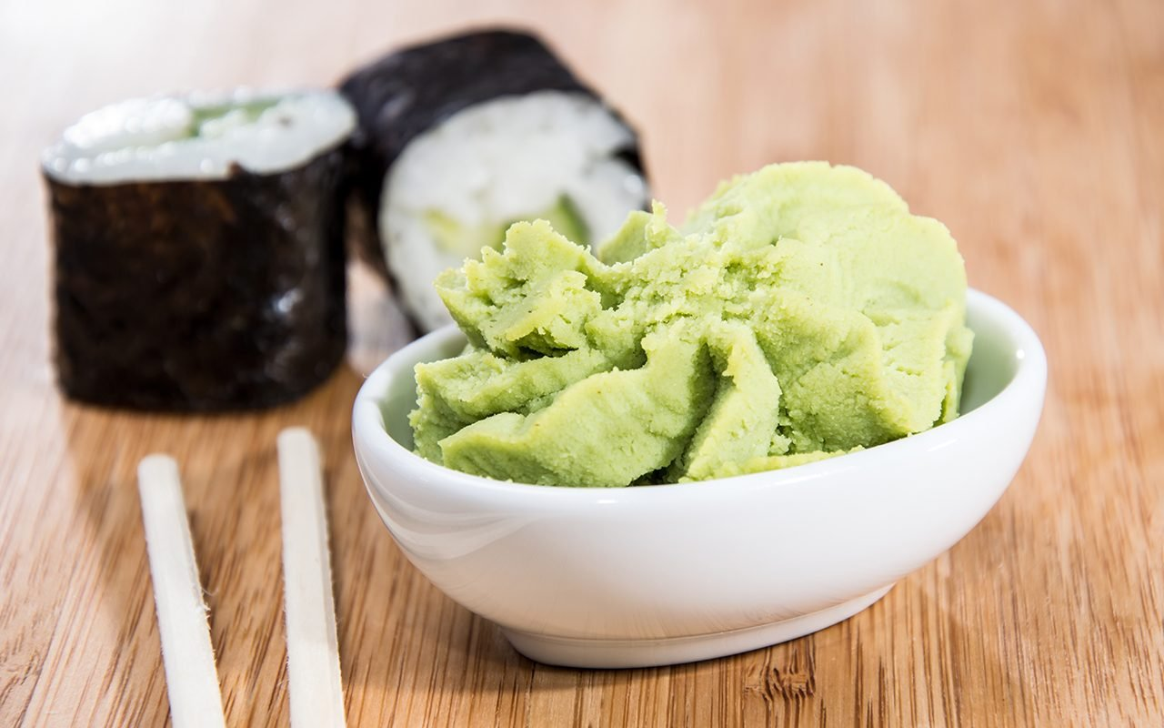
ANSWER # 19
WASABI

Slide 52
QUESTION # 20
THE GOVERNMENT
WAGER UP TO 15 POINTS
SERVING DURING THE KENNEDY, JOHNSON, AND NIXON ADMINISTRATIONS, CURRENTLY AT 104 YEARS OLD, WHO IS THE HIGHEST RANKING, OLDEST-LIVING FORMER U.S. GOVERNMENT OFFICIAL?

Slide 53
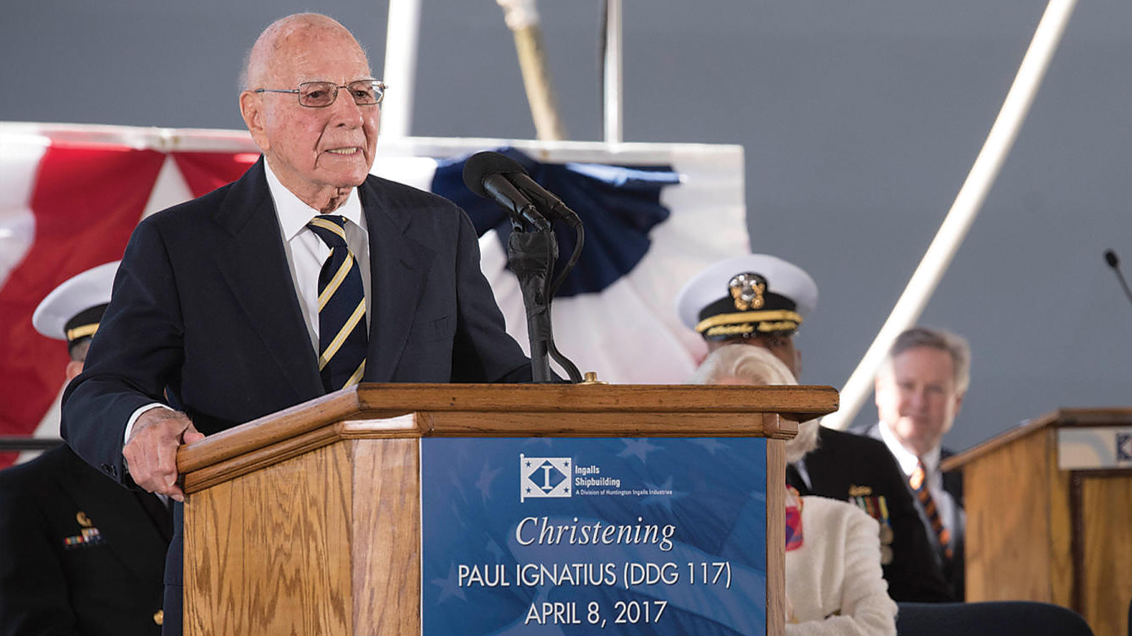
ANSWER # 20
PAUL IGNATIUS

Slide 54
TIE BREAKER ANSWER
831

Slide 55
FINAL RESULTS
1ST $500 – CLUB PENGUIN
2ND $300 – LITE
3RD $150 – B SQUAD
4TH $50 – COUSIN EDDIE’S KIDS
5TH $50 GIFT CARD – SQUANDERERS
6TH $40 GIFT CARD – ONE MINUTE REMAININ
13TH $25 GIFT CARD – MARKSMEN

Slide 56
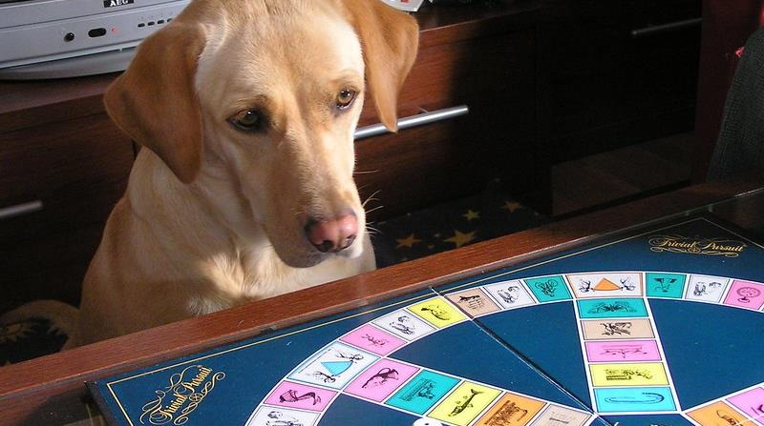
thank you for
a great season!
triviamaryland

