Slide 1
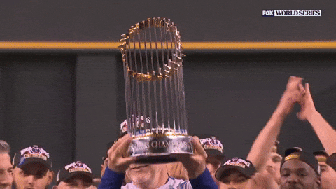
TRIVIAMARYLAND
TRIVIAMARYLAND.COM FACEBOOK.COM/TRIVIAMARYLAND

Slide 2
HERE ARE YOUR FALL 2025 WORLD SERIES TEAMS
NORTH REGION
B-SQUAD
LINCOLN LOVES ZJ’S
MASTER DEBATORS
THE MISFITS
PROST
WEST REGION
ALL OR NOTHING
DEATH PUMP
THE JUNEBUGS
THE MARKSMEN
THINKIN’ N DRINKIN’
VINO > U
SOUTH REGION
ALTERNATIVE FACTS
DOH
GFE’S
POKER IN THE REAR
SENIOR MOMENTS
WE THOUGHT IT WAS BINGO NIGHT
ZESTY HOT COURAGE
CENTRAL REGION
I’M WITH STUPID
NORFOLK & WAY
NU WORLD ORDER
THE SQUANDER-ERS
THE WOOKIES

Slide 3
Question #1
  SLOGANS
    WHICH RESTAURANT CHAIN THAT STARTED IN 1996 AND EXPANDED TO MARYLAND IN 2023 HAS “ONE LOVE” AS ITS SLOGAN?

Slide 4

Answer #1
RASING CANE’S CHICKEN FINGERS

Slide 5
TIE BREAKER
  ACCORDING TO WORLD POPULATION REVIEW, CURRENT POPULATION OF THE COUNTRY OF BURUNDI

Slide 6
Question #2
  NFL
4-PARTS
WHAT ARE THE ONLY FOUR TEAMS TO APPEAR IN AT LEAST ONE SUPER BOWL AND ARE UNDEFEATED?

Slide 7

Answer #2
BALTIMORE RAVENS (2-0)
TAMPA BAY BUCCANEERS (2-0)
NEW ORLEANS SAINTS (1-0)
NEW YORK JETS (1-0)

Slide 8
Question #3
  CARTOGRAPHY TERMS
  NAMED FOR A 1569 FLEMISH MAPMAKER, WHAT IS THE TWO WORD TERM WHICH INFLATES THE SIZE OF LAND MASSES ON MAPS THE FARTHER AWAY FROM THE EQUATOR THEY ARE LOCATED?

Slide 9
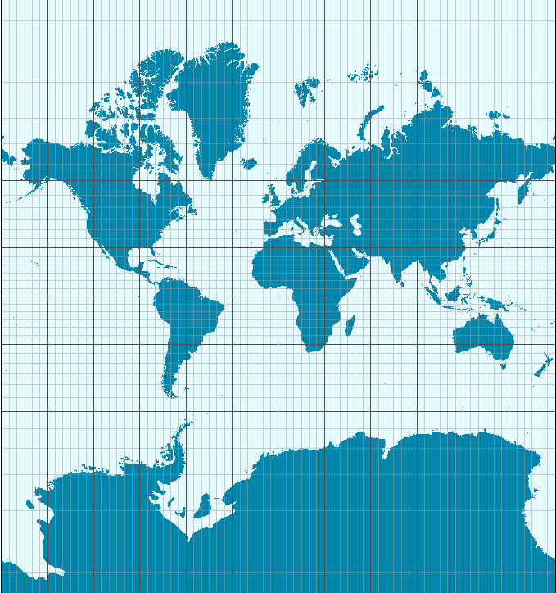
Answer #3
MERCATOR PROJECTION

Slide 10
Question #4
  THE RECORDING INDUSTRY
3-PARTS
ACCORDING TO THE RIAA, WHICH THREE FEMALE SOLO ARTISTS HAVE MORE THAN TWO ALBUMS CERTIFIED DIAMOND (10,000,000 COPIES SOLD)?

Slide 11

Answer #4
SHANIA TWAIN
WHITNEY HOUSTON
MARIAH CAREY

Slide 12
Question #5
HIGHWAYS
WHAT VIRGINIA COUNTY DO YOU ENTER AS YOU CROSS THE POTOMAC RIVER SOUTH ON US 301 FROM MARYLAND?

Slide 13
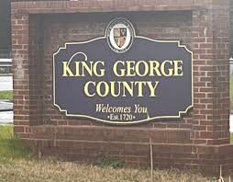
Answer #5
KING GEORGE COUNTY

Slide 14
Question #6
VISUALS
5-PARTS
NAME THE MOVIE DIRECTOR

Slide 15
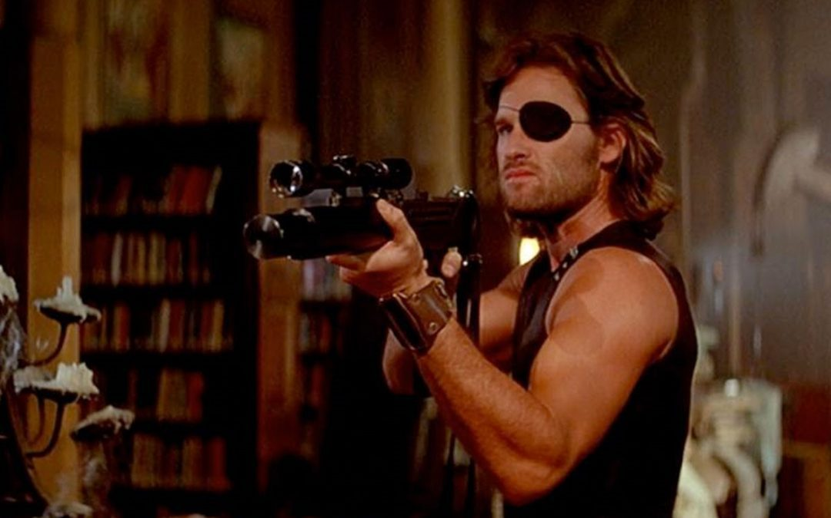
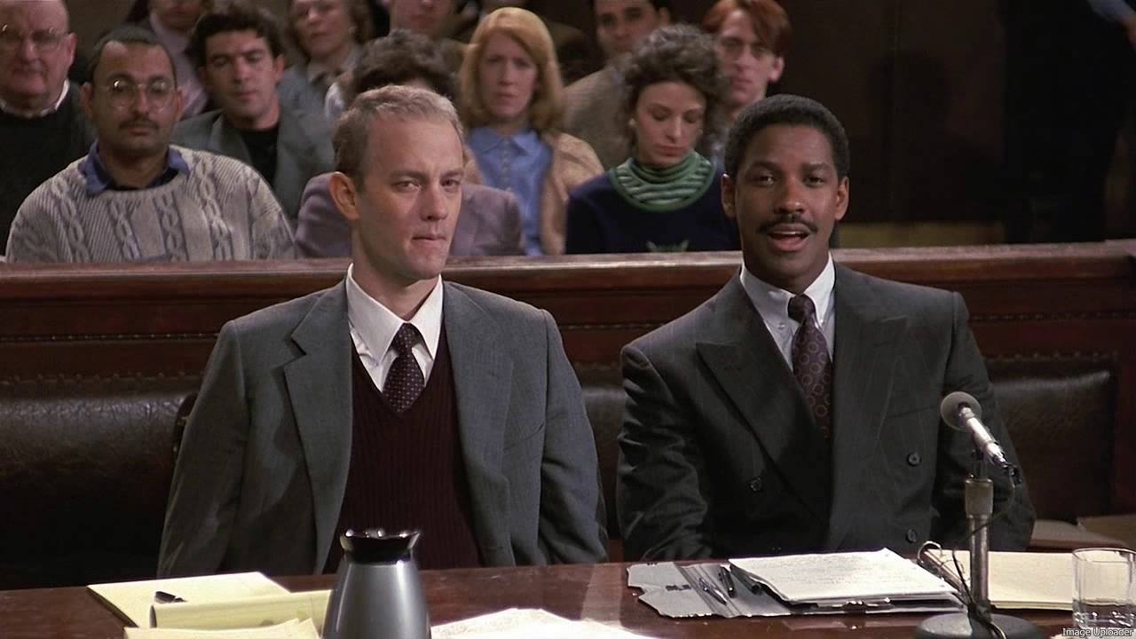
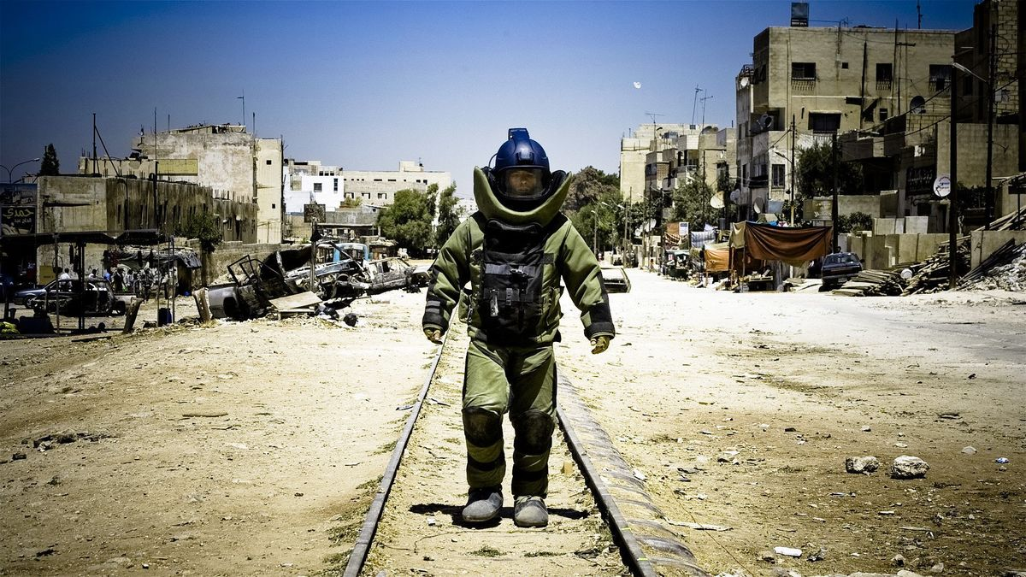
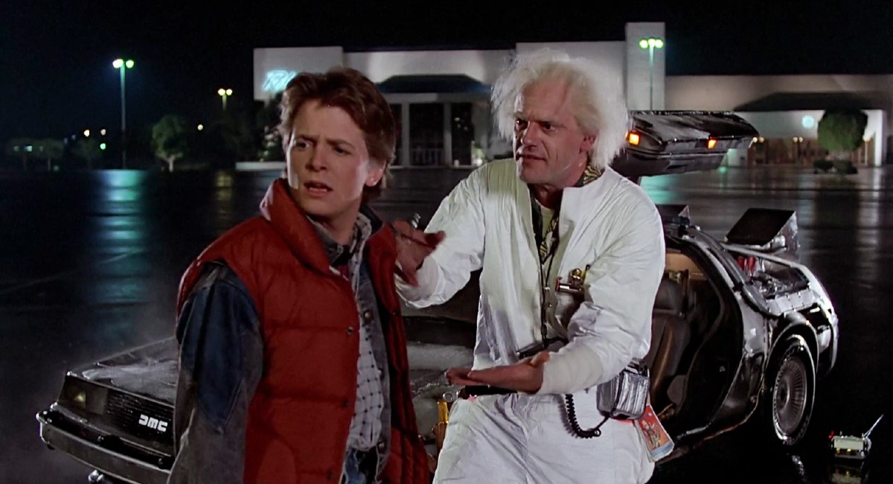
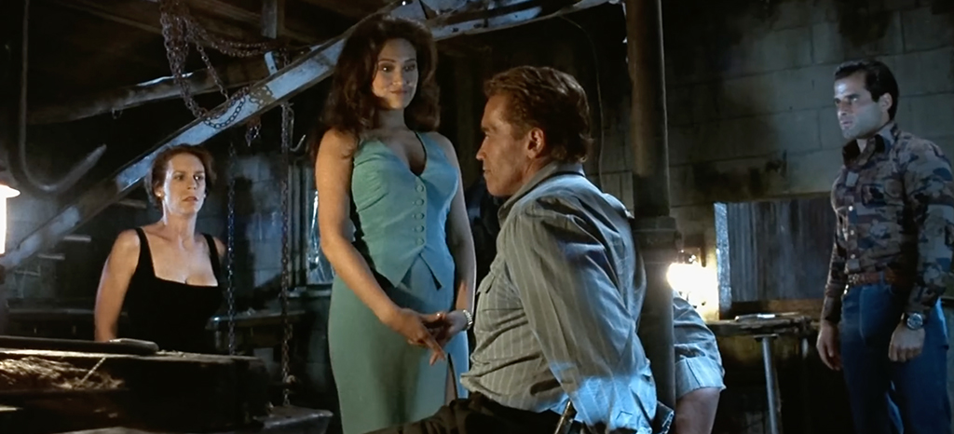
Question #6
VISUALS
NAME THE MOVIE DIRECTOR

Slide 16
Answer #6
JAMES CAMERON TRUE LIES
JOHN CARPENTER ESCAPE FROM NEW YORK
JONATHAN DEMME PHILADELPHIA
ROBERT ZEMECKIS
BACK TO THE FUTURE
KATHRYN BIGELOW THE HURT LOCKER

Slide 17
Question #7
FALL WORLD SERIES CHRISTMAS QUESTION
  EVEN THOUGH THE EVENTS TOOK PLACE IN THE FICTIONAL TOWN OF HOHMAN, INDIANA JUST OUTSIDE CHICAGO, THE ACTUAL HOUSE IN A CHRISTMAS STORY IS LOCATED IN WHICH CITY WHERE IT IS A MUSEUM?

Slide 18
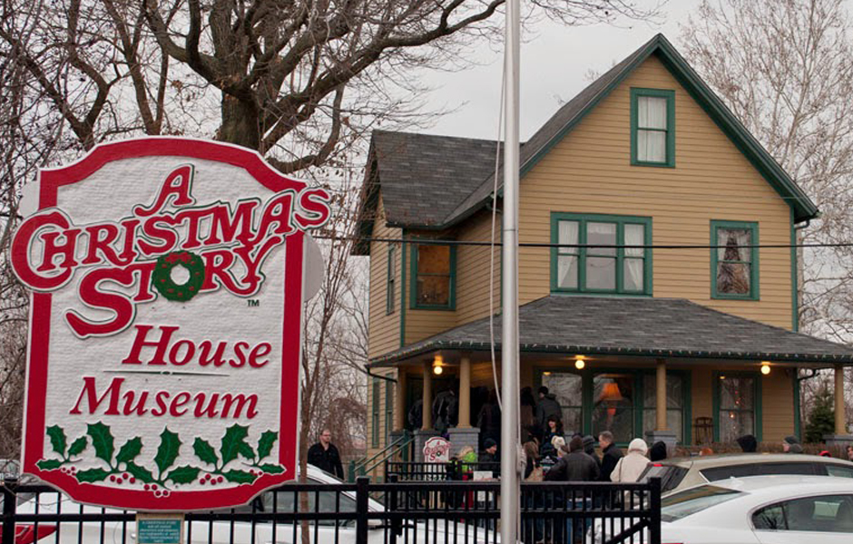
ANSWER #7
CLEVELAND

Slide 19
Question #8
THE OSCARS
5-PARTS
WHICH SIX ACTORS HAVE WON BOTH A BEST ACTOR AND A BEST SUPPORTING ACTOR OSCAR?

Slide 20
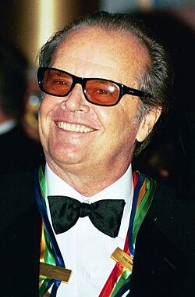
Answer #8
JACK NICHOLSON
JACK LEMMON
ROBERT DENIRO
GENE HACKMAN
KEVIN SPACEY
DENZEL WASHINGTON

Slide 21
Question #9
COMMON BONDS
  WHAT DO MINING ENGINEER VASILI SAMARASKY-BYKHOVETS LAND OWNER JOHN LIVERMORE AND PHYSICIST JOHAN GADOLIN HAVE IN COMMON?

Slide 22
Answer #9
ALL HAVE CHEMICAL ELEMENTS NAMED AFTER THEM

Slide 23


Question #10
Music
3-Parter
NAME THE ORIGINAL STUDIO ALBUM THE FOLLOWING SONGS WERE RELEASED:

Slide 24
Answer #10
ALBUM #1:
÷ (DIVIDE)
“SHAPE OF YOU”
ALBUM #2:
BEGGARS BANQUET
“SYMPATHY FOR THE DEVIL”
ALBUM #3:
SON OF A SON OF A SAILOR
“CHEESEBURGER IN PARADISE”

Slide 25


Halftime
TRIVIAMARYLAND.COM
FACEBOOK.COM/TRIVIAMARYLAND

Slide 26
Question #11
  STREAMING TELEVISION
  AIRING ITS FINAL EPISODE THIS YEAR, WHAT WAS THE FIRST STREAMING SERIES TO WIN THE PRIMETIME EMMY AWARD FOR OUTSTANDING DRAMA SERIES?

Slide 27

Answer #11
THE HANDMAID’S TALE

Slide 28
Question #12
  7-3-1
I AM A 20TH CENTURY FOREIGN WORLD LEADER BORN IN 1890 AND DIED IN 1969. MY COMMON NAME IS DERIVED FROM A PHRASE MEANING “HE WHO HAS BEEN ENLIGHTENED.”
I ATTENDED THE COMMUNIST CONGRESS IN 1921 IN MARSEILLE, FRANCE GOING UNDER THE ALIAS NGUYEN AI QUOC.
I WAS THE 1ST PRESIDENT OF THE DEMOCRATIC REPUBLIC OF VIETNAM FROM 1945-1969. THE CITY OF SAIGON’S NAME WAS CHANGED IN 1976 TO BE NAMED AFTER ME.

Slide 29
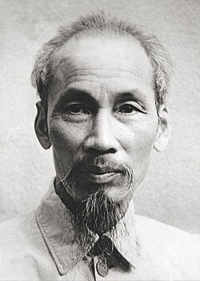
Answer #12
HO CHI MINH

Slide 30
Question #13
BOOK CLUB
    WRITTEN BY RACHEL EKSTROM COURAGE AND PUBLISHED IN APRIL OF THIS YEAR, THE NEW YORK TIMES BESTSELLER MURDER BY CHEESECAKE IS THE FIRST IN A SERIES OF MYSTERY NOVELS INVOLVING WHICH FOURSOME?

Slide 31

Answer #13
THE GOLDEN GIRLS

Slide 32
Question #14
NORTH AMERICAN GEOGRAPHY
4-PARTS
OF THE 10 LONGEST RIVERS IN NORTH AMERICA, WHICH 4 LIE COMPLETELY IN OR PARTIALLY IN CANADA?

Slide 33
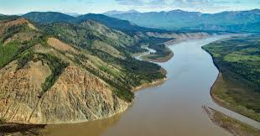
Answer #14
YUKON RIVER
COLUMBIA RIVER
SASKATCHEWAN RIVER
PEACE RIVER

Slide 34
Question #15
NATURAL HISTORY
  WHAT IS THE NAME OF THE LOBED-FINNED FISH THAT WAS DISCOVERED OFF THE COAST OF SOUTH AFRICA IN 1938 THAT WAS THOUGHT TO BE EXTINCT FOR MORE THAN 410 MILLION YEARS?

Slide 35
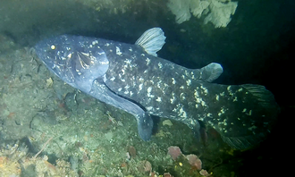
Answer #15
COELACANTH

Slide 36
Question #16
VISUALS
5-PARTS
WHO ARE WE (FIRST AND LAST NAME)

Slide 37
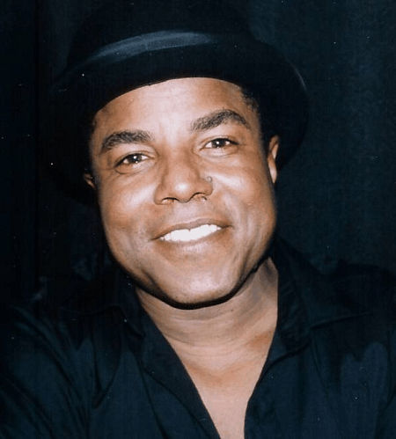
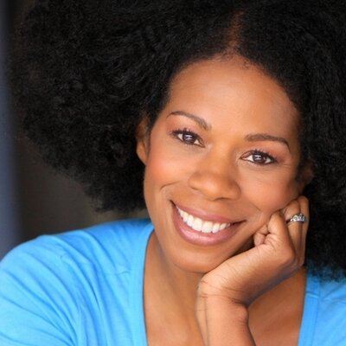
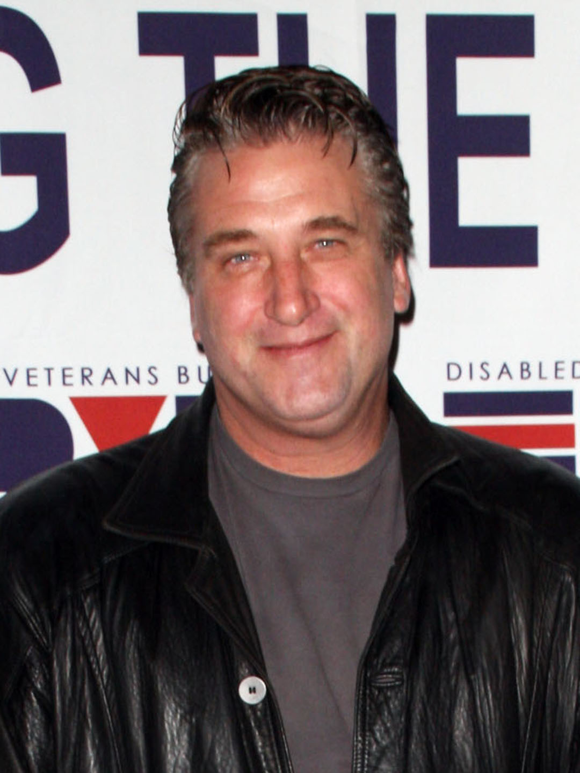
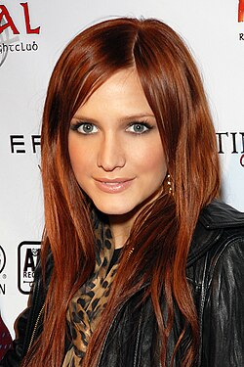

Question #16
VISUALS
WHO ARE WE (FIRST AND LAST NAME)

Slide 38
Answer #16
DANIEL BALDWIN
KIERAN CULKIN
KIM WAYANS
TITO JACKSON
ASHLEE SIMPSON

Slide 39
Question #17
  STAGE NAMES
  MARIAH AMANI BUCKLES WHOSE 2025 ALBUM HEARTS SOLD SEPARATELY REACHED #1 ON THE U.S. R&B CHARTS IS KNOWN BY WHICH STAGE NAME?

Slide 40

Answer #17
MARIAH THE SCIENTIST

Slide 41
Question #18
  U.S. PRESIDENTS
4-PARTS
WHO WERE THE ONLY FOUR INDIVIDUALS TO WIN A U.S. PRESIDENTIAL ELECTION WHILE LOSING THE U.S. STATE OF THEIR CURRENT RESIDENCE?

Slide 42
Answer #18
DONALD TRUMP (2016 – NEW YORK)
RICHARD NIXON (1968 – NEW YORK)
WOODROW WILSON (1916 – NEW JERSEY)
JAMES POLK (1844 – TENNESSEE)

Slide 43
Question #19
DIPLOMACY
    OF THE ORIGINAL NATIONS THAT SIGNED THE NORTH ATLANTIC TREATY ORGANIZATION (NATO), WHICH ONE IS THE ONLY LANDLOCKED COUNTRY?

Slide 44
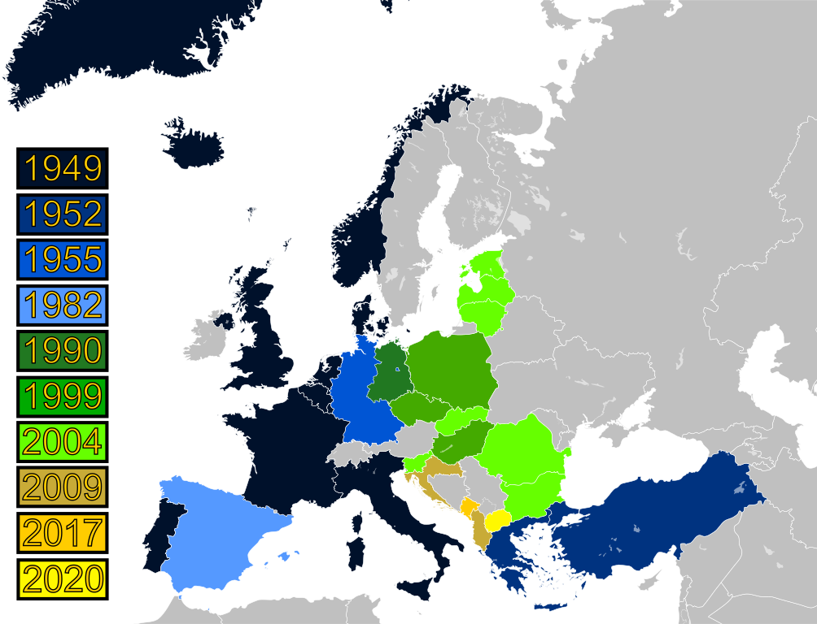
Answer #19
LUXEMBOURG

Slide 45
Question #20
BEFORE THEY WERE FAMOUS
Bet up to 15 pts
  WHICH ACTOR, WHO WOULD LATER BE NOMINATED FOR EMMY AND ACADEMY AWARDS, LIED ABOUT HIS AGE TO GET A ROLE AS A SOLDIER IN THE MOVIE APOCALYPSE NOW AS A 14-YEAR-OLD?

Slide 46
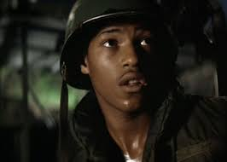
Answer #20
LAURENCE FISHBURNE

Slide 47

TRIVIAMARYLAND
TRIVIAMARYLAND.COM
FACEBOOK.COM/TRIVIAMARYLAND

Slide 48
TIE BREAKER ANSWER
  14,463,233

